Slide 1

Road transport electrification, a new highway to energy saving
International Conference on
SUSTAINABILITY AND ENERGY ISSUES
Bruxelles, September 7, 2017
Maria Lelli, Gabriella Messina, Giovanni Pede ; DTE-PCU-STMA

Slide 2
Presentation lay-out
Energy consumption in the transport sector: an overview of the italian automotive market
Why to electrify the sector
Fuel consumption, homologation cycle & real-world drive: deepening the analysis
Results & conclusions

Slide 3
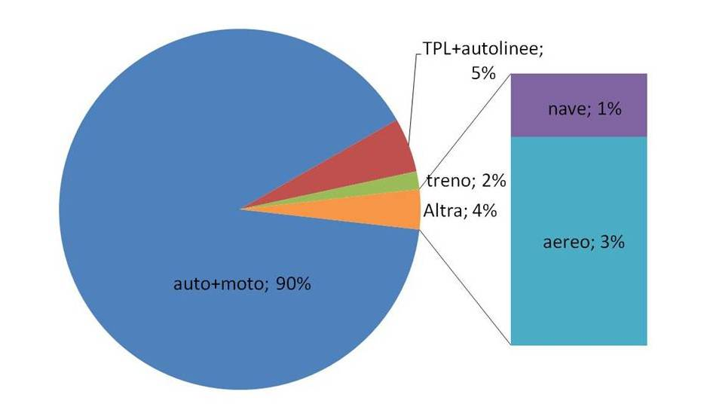
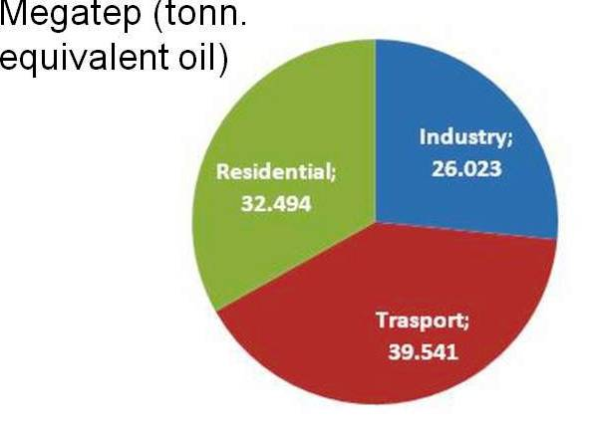
The transportation share of the italian energy balance
Notes:
The transport sector, consuming about 39.54 Megaton equivalent oil (Source: National Energy Balance 2016 ), accounts for more than one-third of the total final energy consumption and is responsible for the Italian dependence on oil; indeed, while other sectors such as the industrial and energy sectors have been converted to alternative fuels, transport has so far not differentiated energy sources, remaining anchored to fossil fuels which continue to be responsible for the prevalent (> 90%) of final consumption of the sector (road transport).

Slide 4
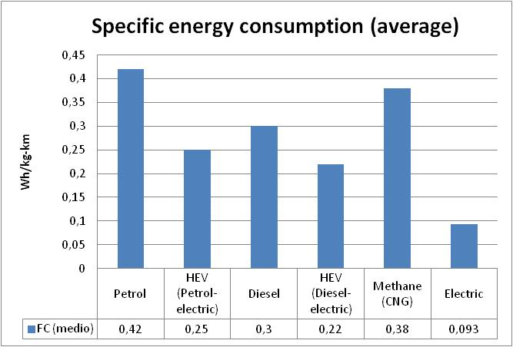
Average traction energy consumption: Tank-to-Wheel
Notes:
In Italy , in 2015, more than 1.57 million passenger cars have been sold, more than 55% diesel-fueled, and an appreciable fleet of hybrid cars (HEVs), in particular petrol-fueled vehicles.
In the slides, average values for specific energy consumption EC (Wh/km kg) of different kind of on-board power plant. Since the energy performance of vehicles depends to a large extent on the weight and power of the vehicle itself, the normalized characteristics (per unit of weight) are reported. The analysis allows to compare vehicles with similar characteristics and different power train.
”Life Cycle Assessment” is very familiar to people in the environmental field. It is used to assess the total environmental performance of a product all along its lifetime.
When talking about fuels, the proper term in use is ”Well-to-Wheel Analysis”.
In order to be able to examine the complete energy-cycle in the transport sector, the chain is often divided into 2 stages:
Well-to-Tank (WTT) and a Tank-to-Wheel (TTW) portions of the Well-to-Wheel analysis.
The Well-to-Tank portion of the whole analysis considers the fuel from resource recovery to the delivery to the vehicle tank, that is, the feedstock production + transportation and the fuel production + distribution.
As everyone can see, the best results Tank-to-Wheel are obtained by “pure electric vehicles”, thanks too the much higher efficiency of electric motors compared to internal combustion engines.
This is not enough to compare electric transport with thermal one, because we need to consider also the Well-to-Tank portion of the whole analysis, i.e. to consider the energy path from resource recovery to the delivery to the vehicle tank/on-board storage, that is,
the feedstock/electricity production
transportation
distribution.

Slide 5
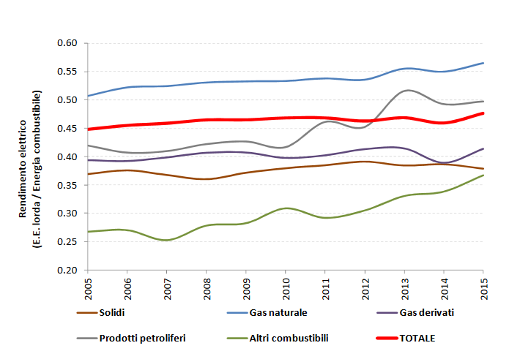
Average E.E. generation efficiency: Well-to-Tank
Notes:
However, the efficiency of a thermoelectric power plant is so higher, even the double with respect to the average of an ICE, to largely offset these losses
This is true in general, but even more true in our country.
Indeed, thanks to the efficiency improvement of the national electricity system, the so called well to tank (WTT) efficiency of a "pure" electric vehicle (BEV) or “plug-in hybrid vehicles” (PHEV) have been substantially improved in recent years, though is still much lower than that one occurring to refine and distribute liquid and gaseous fuels. The increase in average efficiency is mainly due to the diffusion of combined cycle systems and cogeneration plants, for the combined production of electricity and heat.

Slide 6


Average total energy consumption: Well-to-Wheel
Petroleum
Conversion efficiency
Petroleum
100
100
45%
Power plant
Petroleum refining
Electricity
82%
Transmission & distribution
94%
Gasoline
Electricity
Tank + engine
Battery + motor
25%
75%
20
30
Notes:
To obtain gasoline or diesel oil, the crude oil must be refined. This process takes up energy in the form of electricity, fuel and steam. The total efficiency is about 82%
In the electric traction systems the bulk of losses is concentrated in the upstream part of the process, and notwithstanding the high efficiency of a thermoelectric power plant, with a total efficiency of about 42%.
On the other hand, the average efficiency of an all-electric automotive power train is three time the efficiency of a thermal one. Therefore, everything considered, average efficiency, from the well to the wheel, of a pure electric vehicle is about 50% higher than the efficiency of a conventional one.

Slide 7
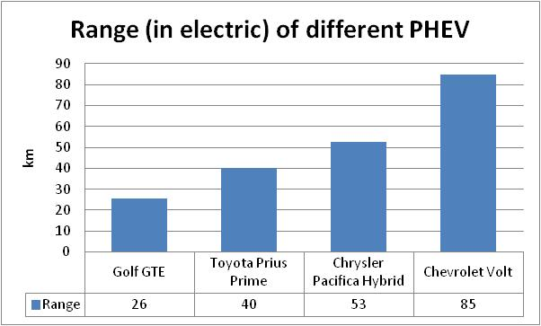
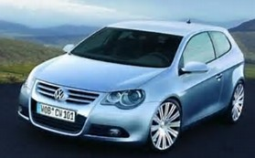
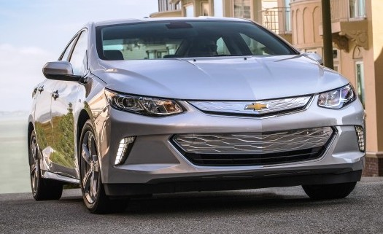
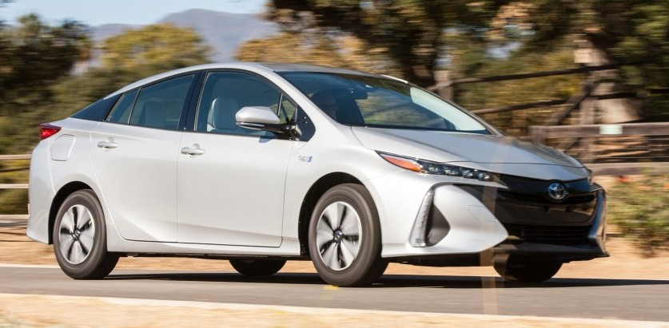
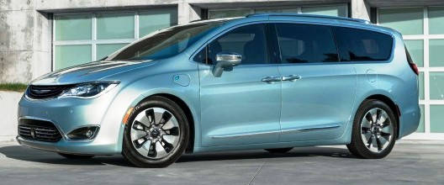
Plug-in hybrid, the best of two motorization
Notes:
A plug-in hybrid electric vehicle (PHEV) is a hybrid electric vehicle that uses rechargeable batteries, or another energy storage device, that can be recharged by plugging it in to an external source of electric power. A PHEV shares the characteristics both of a conventional hybrid electric vehicle, having an electric motor and an internal combustion engine (ICE), and of an all-electric vehicle, having a plug to connect to the electrical grid.

Slide 8
Well-to-Tank energy consumptions for different fuelled class B VOLKSWAGEN cars (Golf & Jetta)
FUEL CONSUMPTION (FC) in L/100 km | Petrol (Golf 1.5) | HEV (Jetta Hybrid) | PHEV (Golf GTE) | BEV (e-Golf)
Urban | 6,20 | 4,4
Extraurban | 4,40 | 3,90
Mixed (NEDC, 37% urban/63% extraurban)) | 5,10 | 4,1 | 1,70
ELECTRIC ENERGY CONSUMPTION (EEC) in Wh/km
Mixed (NEDC) |  |  | 124 | 139
ENERGY CONSUMPTION (EC) in Wh/km
EEC |  |  | 124 | 139
FC | 467 | 375 | 156
Mixed (NEDC) | 467 | 375 | 280 | 139
Notes:
To overcome the differences, in weight and power, in the characteristics of the different commercialized vehicles, we compared the energy consumption of different versions for the same car model, the VW Golf.
For this model there are on the market three different kind of power train: gasoline, electric, plug-in hybrid (PHEV). To hybrid too (HEV) too, a car of the same manufacturer (Jetta) that has similar characteristics, was considered.
In the table, there are the specific consumption data declared by VW, with the distinction between electric energy consumption and gasoline consumption for plug-in hybrids.
Consumptions are measured according to the homologation cycles.

Slide 9
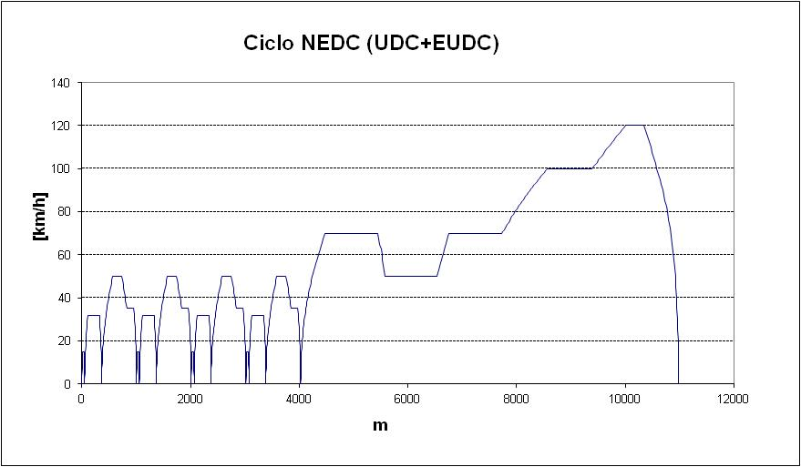
Homologation cycle
37%
63%
Notes:
The New European Driving Cycle (NEDC) is a driving cycle, last updated in 1997, designed to assess the emission levels of car engines and fuel economy in passenger cars (which excludes light trucks and commercial vehicles). It is the so-called “homologation cycle”.
It consists of four repeated ECE-15 urban driving cycles (UDC) and one Extra-Urban driving cycle (EUDC).
It is maintained by the UNECE World Forum for Harmonization of Vehicle Regulations (WP.29),^{[3]} which also works on its successor, the Worldwide harmonized Light vehicles Test Procedures (WLTP).^{[4]}
Although originally designed for petrol-based road vehicles, the driving cycle is now also used for diesel vehicles and to estimate the electric power consumption and driving range of hybrid, but, as everyone can see, the extraurban part is predominant, in terms of mileage, with respect to the urban part ((3,9 km vs. 6,9 km).
Since it is crucial to use a test cycle that reflects real-world driving style, speaking of plug-in hybrid or battery vehicle the predominant part should be considered the urban part.

Slide 10

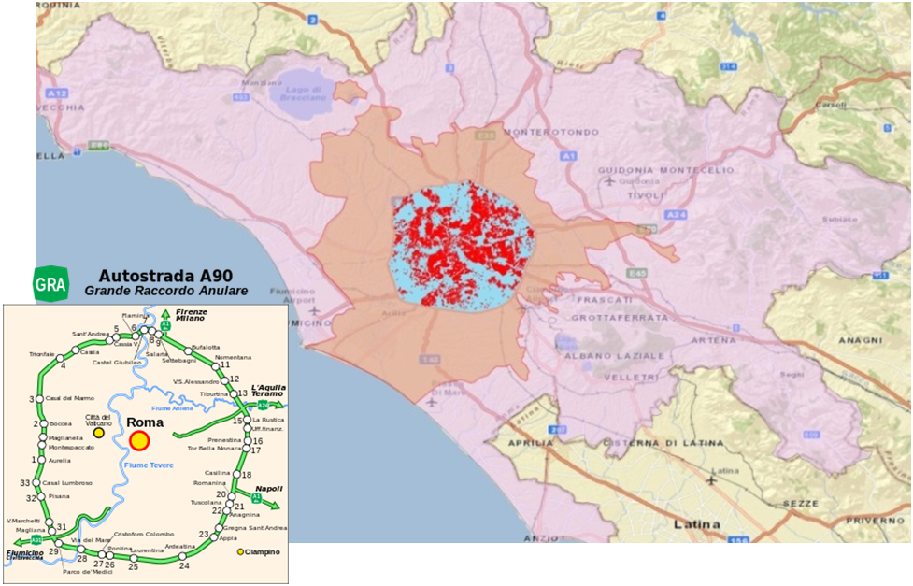
Real use of a plug-in hybrid: monitoring
The selected database, which refers to the whole month of May 2011, was employed to identify data related to the geographic distribution of trips, parking times and total daily distance travelled
GPS/GSM on board “black-box”
The 16,615 selected vehicles present an average monthly mileage of 730 km/vehicle well oriented towards urban trips
driver’s homes (red dot)
129 km
98 km
highway ring GRA
Notes:
To investigate the real mileage covered by drivers and understanding how much range can be covered by EVs we need to carry out an analysis based on daily driving patterns.
Recent advances in space based navigation system technology, as GPS, and related reductions in equipment cost have suggest to use GPS data for travel surveys.
To perform the national project on Electromobility carried out in the framework of the National Research Program on Electricity Grid ENEA (Italian National Agency for New Technologies, Energy and Sustainable Economic Development) acquired from a private company specialized in vehicle monitoring for safety and security applications, a set of these data collected with GPS/GSM devices that represent many mobility patterns in the Province of Rome.
Of all the vehicles present in the database thus obtained, a possible homogeneous sample was selected, identifying vehicles that are resident within the ring road that surrounds Rome (in italian “Grande raccordo anulare, GRA) and which never run, during the month, outside the rectangular area that surrounds the province of Rome.

Slide 11
Real use of a plug-in hybrid: “big data” analisys results
Notes:
The sample so selected is made up of 16,615 vehicles, and it was hypothesized that they all could be replaced by Phev hybrids.
Then the behavior of Phev vehicles (with 3 different electrical autonomy of 10, 20 and 40 miles) has been considered.
Finally it was then calculated for all the vehicles, which would be the monthly “only electric” runnig, in two different cases: only night recharging or overnight charging + intermediate recharges (low power) during stops longer than 1 hour. The results are reported in the figure.
For all PHEVs model the percentage of mileage in electric mode obviously increases with the allowed range in pure electric mode, i.e. with the size of the battery
The first column represents this percentage when intermediate charging is made, the second one the same without (only night charging).
Let we consider overnight charging only, i.e. the smaller values.

Slide 12
Well-to-Tank energy consumptions for different fuelled class B VOLKSWAGEN cars (Golf & Jetta)
FUEL CONSUMPTION (FC) in L/100 km | Petrol (Golf 1.5) | HEV (Jetta Hybrid) | PHEV (Golf GTE) | BEV (e-Golf)
Urban | 6,20 | 4,4
Extraurban | 4,40 | 3,90
Mixed (NEDC, 37% urban/63% extraurban)) | 5,10 | 4,1 | 1,70
ELECTRIC ENERGY CONSUMPTION (EEC) in Wh/km
Mixed (NEDC) |  |  | 124 | 139
ENERGY CONSUMPTION (EC) in Wh/km
EEC |  |  | 124 | 139
FC | 467 | 375 | 156
Mixed (NEDC) | 467 | 375 | 280 | 139
Notes:
As the plug-in hybrid are chosen by people used to drive in the city (otherwise, their high investment cost is not justified with respect to a diesel car), it needs to recalculate FC and EC according to real-use percentages as resulting in a study by ENEA, to better estimate the balance between electric engine and ICE use.
It was assumed that the plug-in hybrid consumes like the hybrid petrol car when it runs in extraurban part, and like the electric car when it moves into electrical (urban part of the homologation cycle).

Slide 13
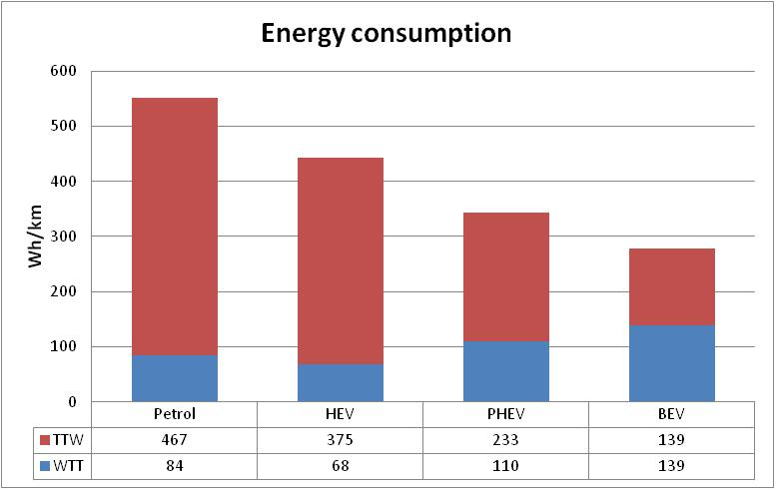
Well-to-wheel specific energy consumption for different fuelled cars (1)
Phev10
Urban EEC: 139 Wh/km
Extraurban FC: 3,9 L/100 km
Mixed revised: 57% “only electric” + 43% in hybrid mode
Notes:
The results, with respect to the gasoline fuelled Golf, are shown in the figure, where the plug-in appears to be approximately halfway between the hybrid and the "pure" electric battery

Slide 14
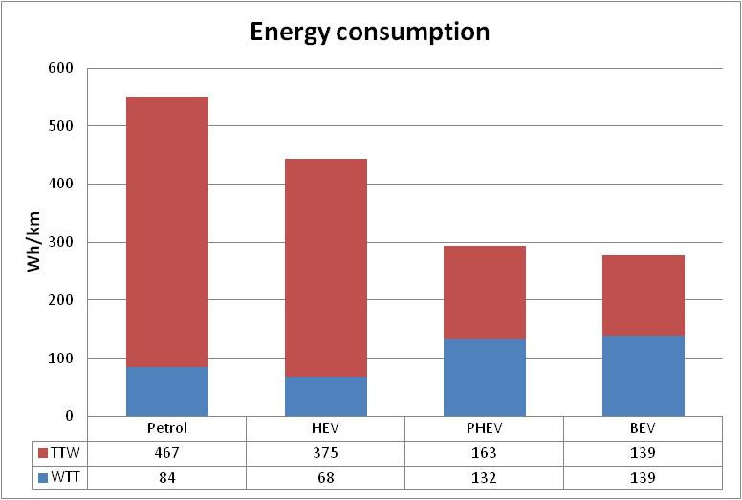
TTW and WTT specific energy consumption for different fuelled cars (2)
Phev 40
Urban EEC: 139 Wh/km
Extraurban FC: 3,9 L/100 km
Mixed revised: 90% in “only electric” + 10% in hybrid mode
Notes:
Of course, with a Phev40 like the Volt the results would be substantially better, because in this case the vehicle can be considered substantially electric.
As a matter of fact, it can run in only electric for the 96.4% of total distance. And even using only night-time charging this percentage drops to 89.7%, remaining very high.

Slide 15
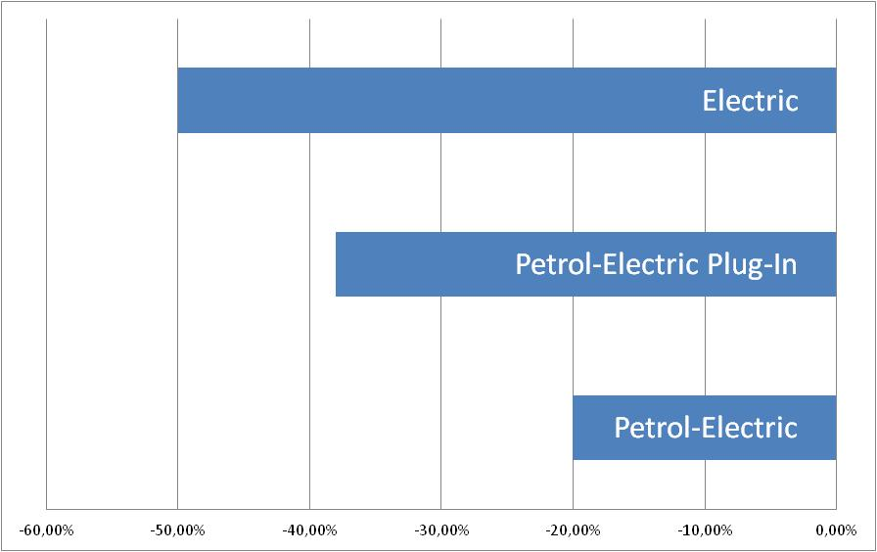
WTW consumption of a Phev10: % reduction with respect to a petrol fuelled car of the same type
Notes:
The results, for the e-Golf, in terms of percentage reduction in energy consumption "from the well to the wheel", with respect to the gasoline fuelled version.
Considering that
in a large urban area (Rome) 40% of the vehicles does not exceed 100 kilometers per week (corresponding to the range of an average electric car rechargeable in 30’, at ultra-fast charging station of 50 kW or more), in this way it is possible, in urban use, to replace these cars with equivalent electric vehicles,
annual primary energy consumption for cars and taxis in cities in 2014 is around 8.9 Mtoe and, finally,
estimating an average energy consumption reduction of about 30%
there would be a 10% reduction in imported fuels consumption.
Even greater is the reduction of greenhouse gas emissions, thanks also to the progressive penetration of renewable sources that have a zero emission. As a matter of fact, electricity from renewable sources, considering hydroelectric production too, rises in 2014 up to 37% , more than doubling with respect to 2005 (17%).
Finally, the (local) emission of harmful and acoustic emissions would be total.

Slide 16
Conclusions (1)
From the results illustrated above, it is clear that electrification of road transport leads to significant energy savings, even in global terms, from the well to the wheel.
In addition to this benefit, the electrification gains another important advantage at local level, in terms of air quality in urban areas, lowering the emissions of toxic and harmful gases.
Of course, CO2 emissions are also reduced, even in comparison to bifuel gasoline-methane vehicles.

Slide 17
Conclusions (2)
Given that the transport sector has become over the years the most critical one in achieving the goals of reducing energy consumption and global emissions in our country, the certain advantages represented by a transition to road vehicles hybridization and electrification would well justify incentive measures similar to those taken (in Italy) in the past with the introduction of Green Certificates and Energy Efficiency Titles.
The range in “pure electric” of the vehicle, i.e. the battery size, has to be the main parameter to be considered to quantify the incentivation.

Slide 18
Giovanni Pede
giovanni.pede@enea.it

