Slide 1
Hybrid models for the evaluation of energy sustainability in urban areas
M. Martino, G. Mutani, M. Pastorelli
Department of Energy «Galileo Ferraris»

Slide 2
Scope of the work
To build reliable energy models for mapping and planning of energy demand and related supply systems for buildings in cities
This topic is considered in several EU funded project (i.e. H2020)

Slide 3
Mapping tool features
Able to process large and complex data sets
Comprehensive description of existing energy systems and dynamic development of supply and demand elements in a given environment
Able to define a Comprehensive assessment for efficient heating and cooling at local and national level
Help to match the energy demand with efficient and sustainable energy source at the least cost

Slide 4
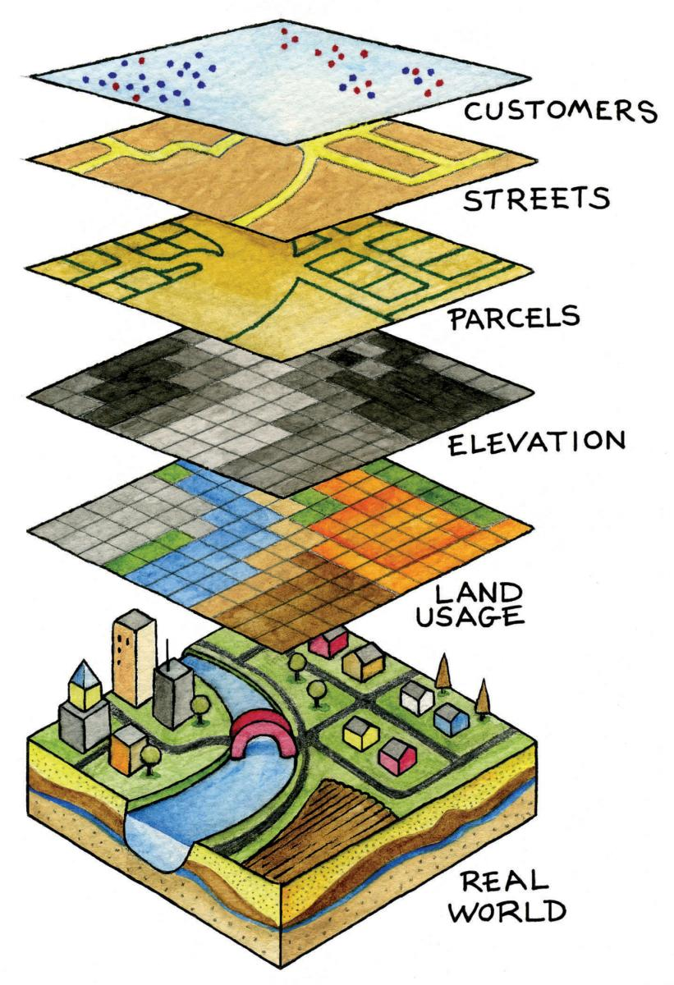
Usually adopted methodologies for energy mapping with GIS based tool
Top-down approach
Bottom-up approach
GIS: Geographic information system

Slide 5
Top-down models
Energy-use data at urban scale are compared with climate variables, census results and statistical surveys to determine average energy consumption for existing buildings
These models can compare different variables, but cannot distinguish spatial variations in energy consumption of a Municipality or a territory

Slide 6
Bottom-up models
These models operate at building scale, and are usually used to evaluate the energy balance of a single building with high detail
Models at building scale need good knowledge of the building characteristics together with measurement of the energy consumption for the validation

Slide 7
Bottom-up models
Simplified models for urban scale
Notes:
Some variables are not controllable such as refurbished old buildings

Slide 8
Models comparison
TOP-DOWN MODELS
(Average) building energy consumption
BOTTOM-UP MODELS
Specific characteristics of each building are required

Slide 9
Who?
JRC-Covenant of Mayors
Metropolitan Cities
Data
Hourly climatic data
Technical Map of the Metropolitan City of Torino (CTP)
Municipal Technical Map for the City of Torino (CTC)
2011 ISTAT census
Thermal and electrical energy consumption data at Municipality scale
PUT/PUMS urban traffic plan and sustainable urban mobility plan
Territorial scale
Top-down model
Statistical model on municipality scale (with a distribution of energy consumption data based on heated volumes or number of users)
Urban scale
Torino case study
Comparison between bottom-up and top-down approaches
Definition of a energy-use model with heating, cooling and electrical energy demand (with the hourly characteristic curve )
Building scale
Who?
Public administrations/Utilities
Municipalities
Data
Buildings’ data: construction period, envelope typologies, system efficiencies, type of users, …
Thermal and electrical energy consumption data at building scale - Users’ behavior
Bottom-up model

Slide 10
Hybrid Model
In a territorial context, the energy consumption of buildings is conditioned by their characteristics (period of construction, surface to volume ratio, typology, occupants behaviour, orientation, …)
By the urban morphology and solar exposure of the neighborhood where the building is located
AND

Slide 11
The quantitative description of the urban morphology and solar exposure are based on 7 key built environment indicators:
building density, BD [m]: the ratio between the total buildings' volumes and the land surface containing the sample buildings;
building height, H [m]: the average height of buildings within the sample area (total buildings’ volumes over total footprint area)
built coverage ratio, BC: ratio between the sum of the buildings' footprint areas and the land surface containing the sample buildings;

Slide 12
aspect ratio, H/W: relationship of a building with his surroundings
Main street orientation MSO: prevalent direction of the streets
Building orientation BO prevalent direction of the building in the block
Albedo A of external surfaces: ratio between the reflected and the incident solar radiation
Notes:
Material effect

Slide 13
To put in evidence the effect of urban form on the energetic behavior of the buildings, two factors have been calculated, at urban scale
Urban Morphology
UM = BC . H/W = BD/W
Solar Exposure:
S = MOS . BO . H/Hm
And the building can be grouped in urban morphology classes

Slide 14
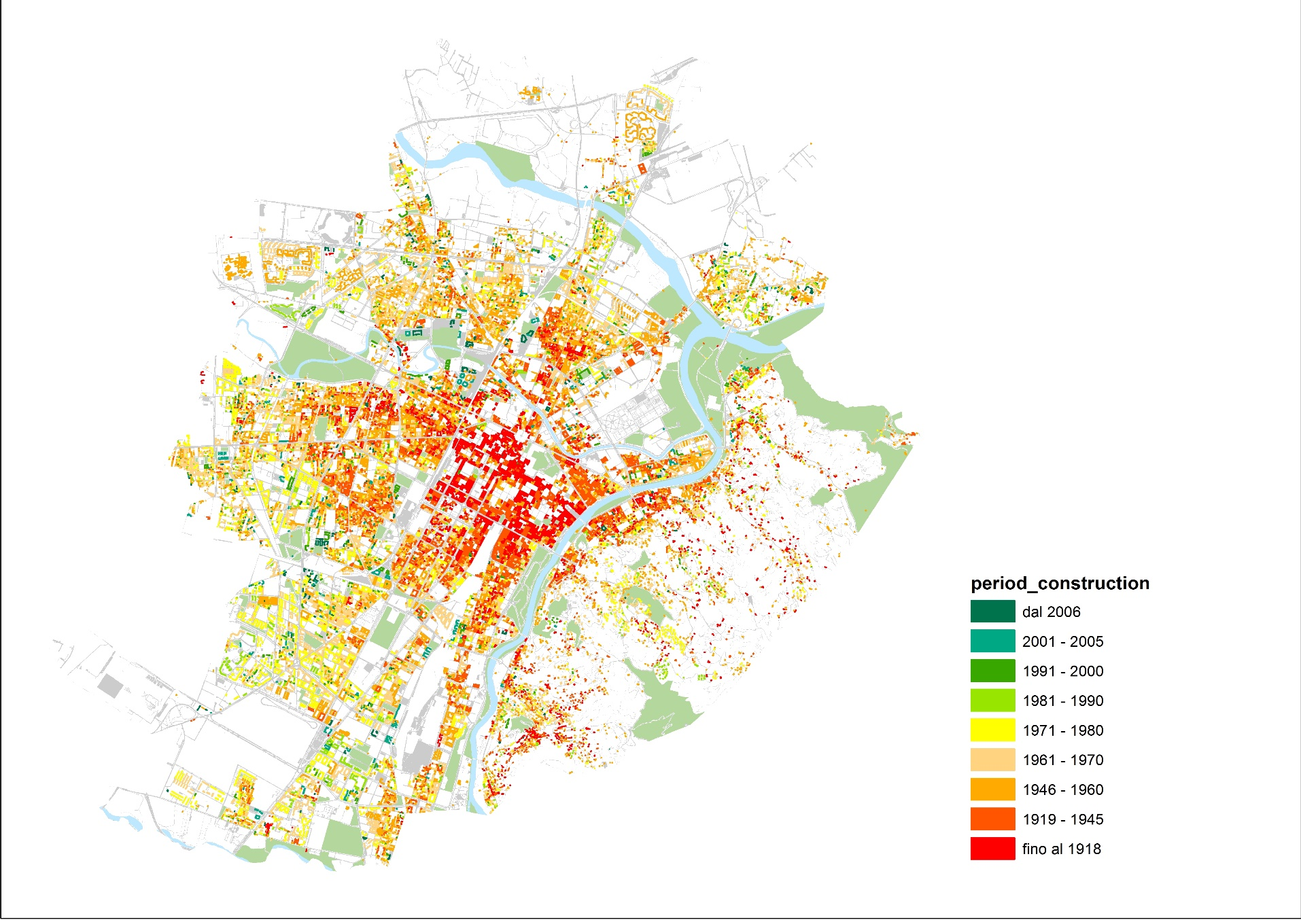
Result of hybrid energy mapping models

Slide 15
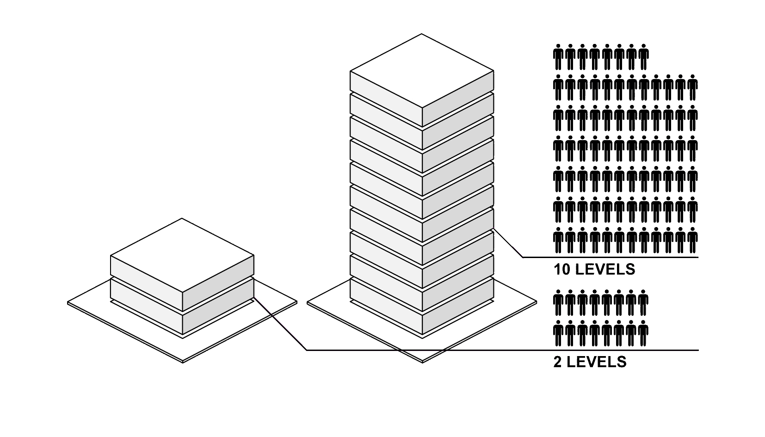
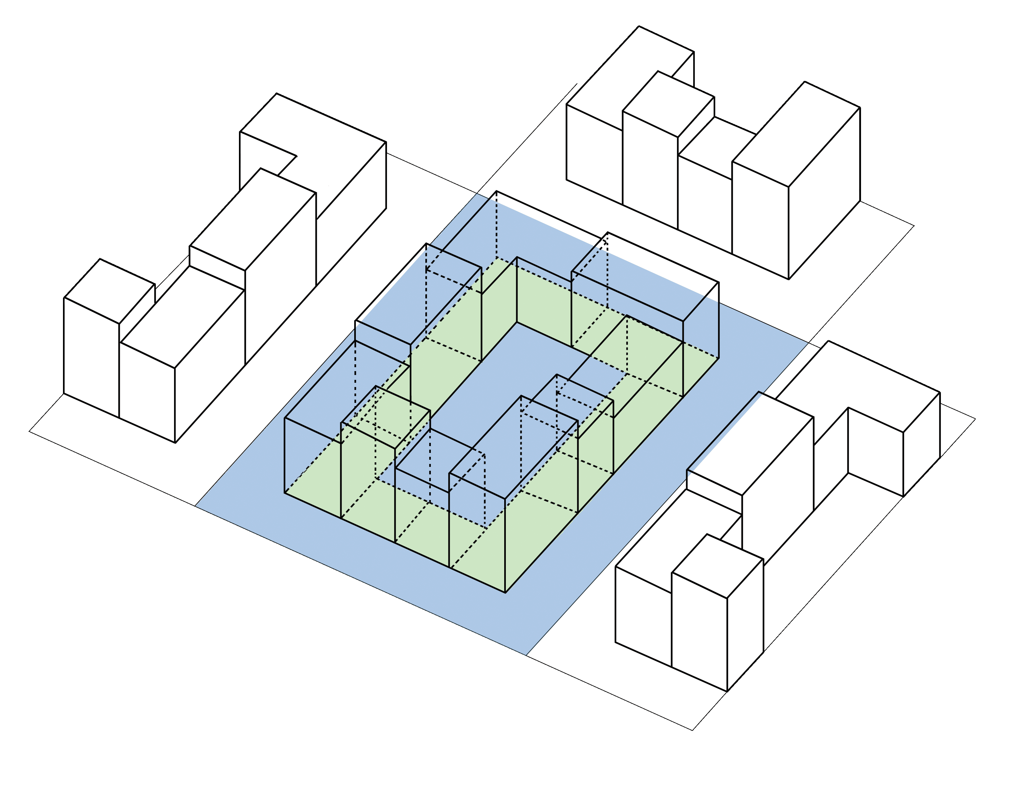
Urban context variables
kWh/m³ _{[CONTEXT]} = f (BD, BCR, H/W, H/Havg, MOS, A)
BD
Building Density [m³/m²]
BCR
Building Coverage Ratio [m²/m²]
Built Area
BD = BCR . Building Height
BCR =
Site Area

Slide 16
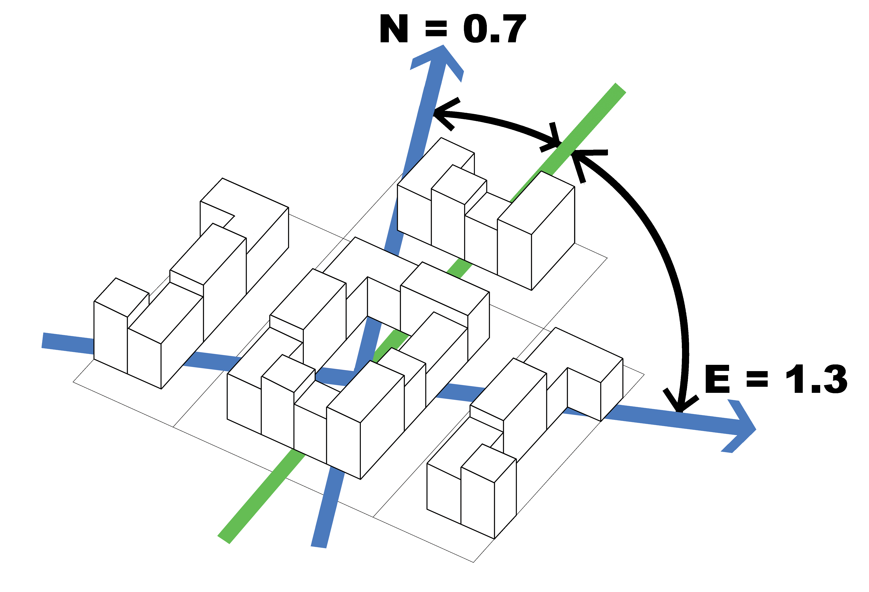
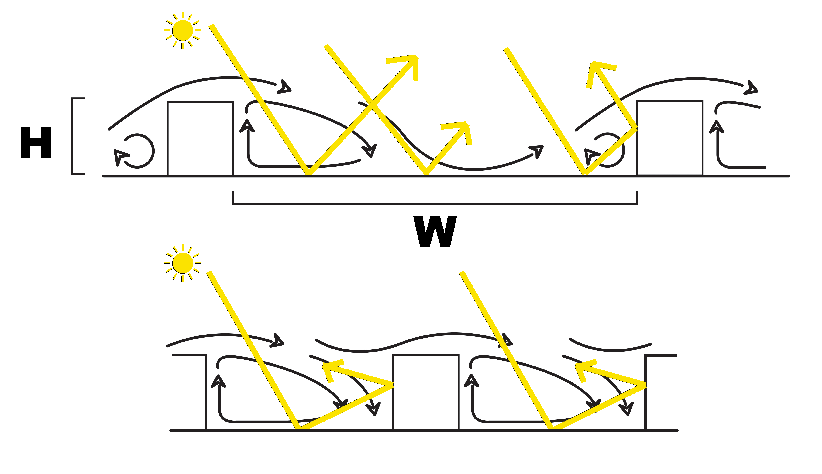
kWh/m³ _{[CONTEXT]} = f (BD, BCR, H/W, MOS, H/Havg, A)
H/W – Height to Distance or Aspect Ratio [m/m]
MOS – Main Orientation of Streets [-]

Slide 17
kWh/m³ _{[CONTEXT]} = f ( BCR, BD, H/W, MOS, H/Havg, A)
H/Havg
building relative Height [m/m]
A
Albedo [-]
ASTER
July 22nd 2004

Slide 18
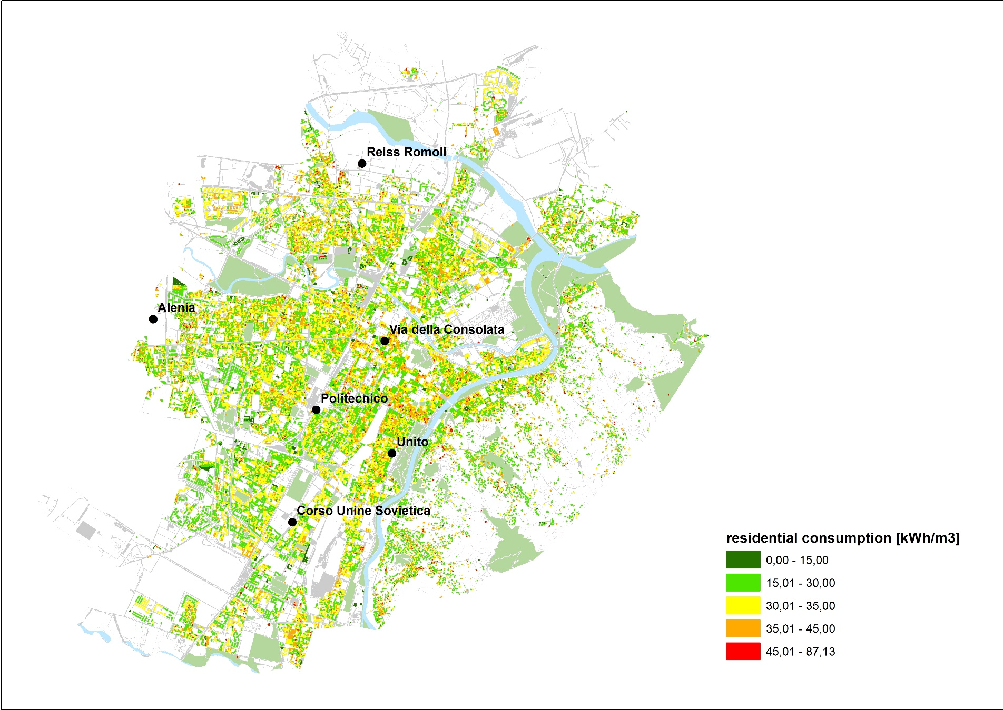
Result of hybrid energy mapping models

Slide 19
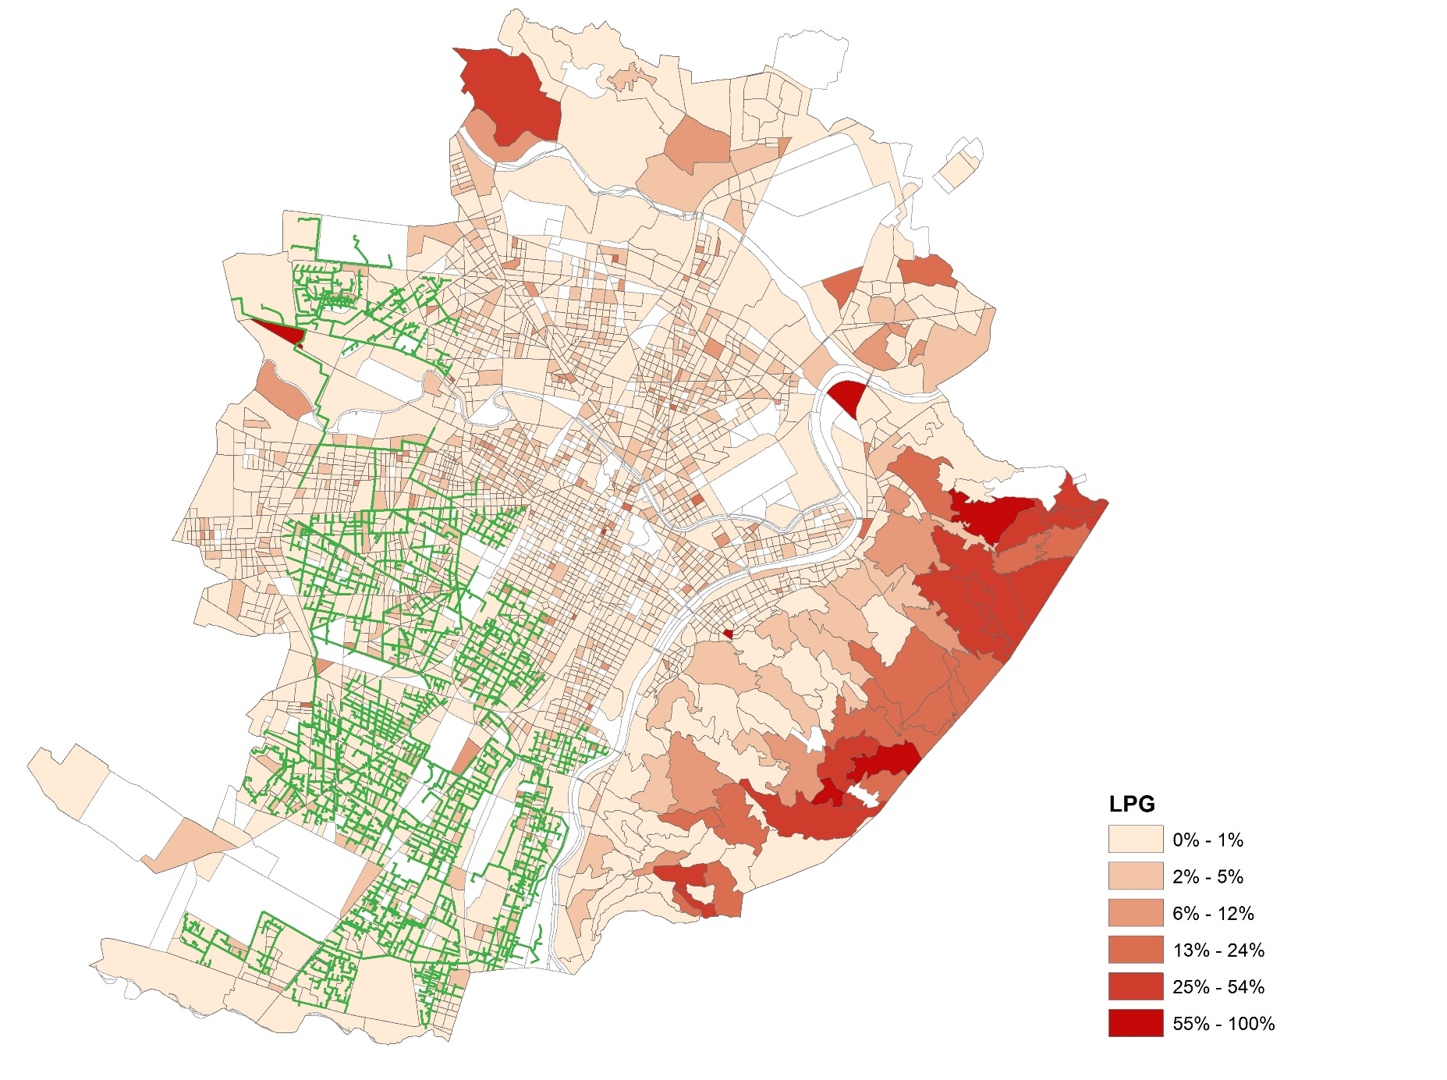
Result of hybrid energy mapping models

Slide 20
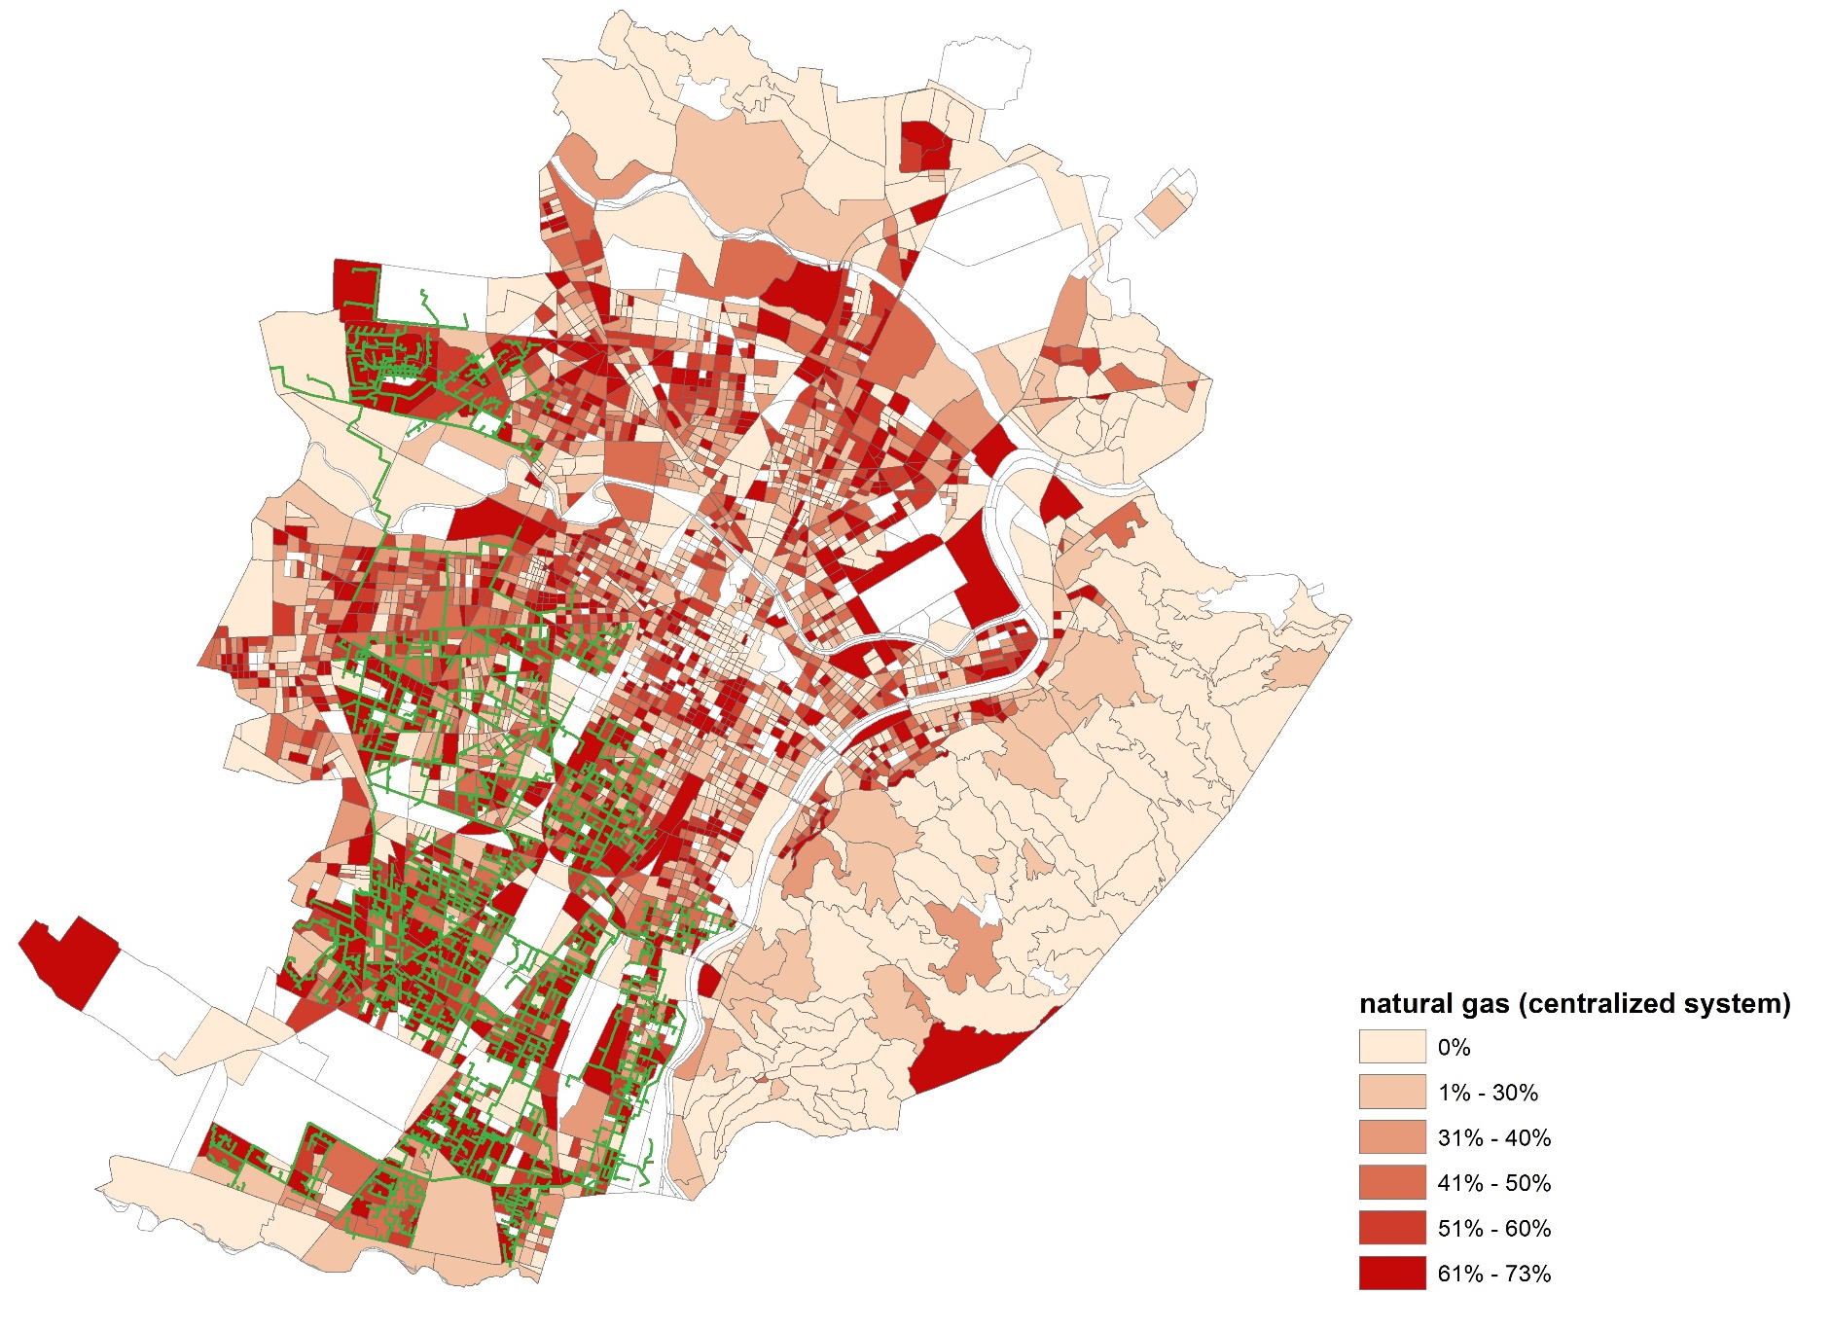
Result of hybrid energy mapping models

Slide 21
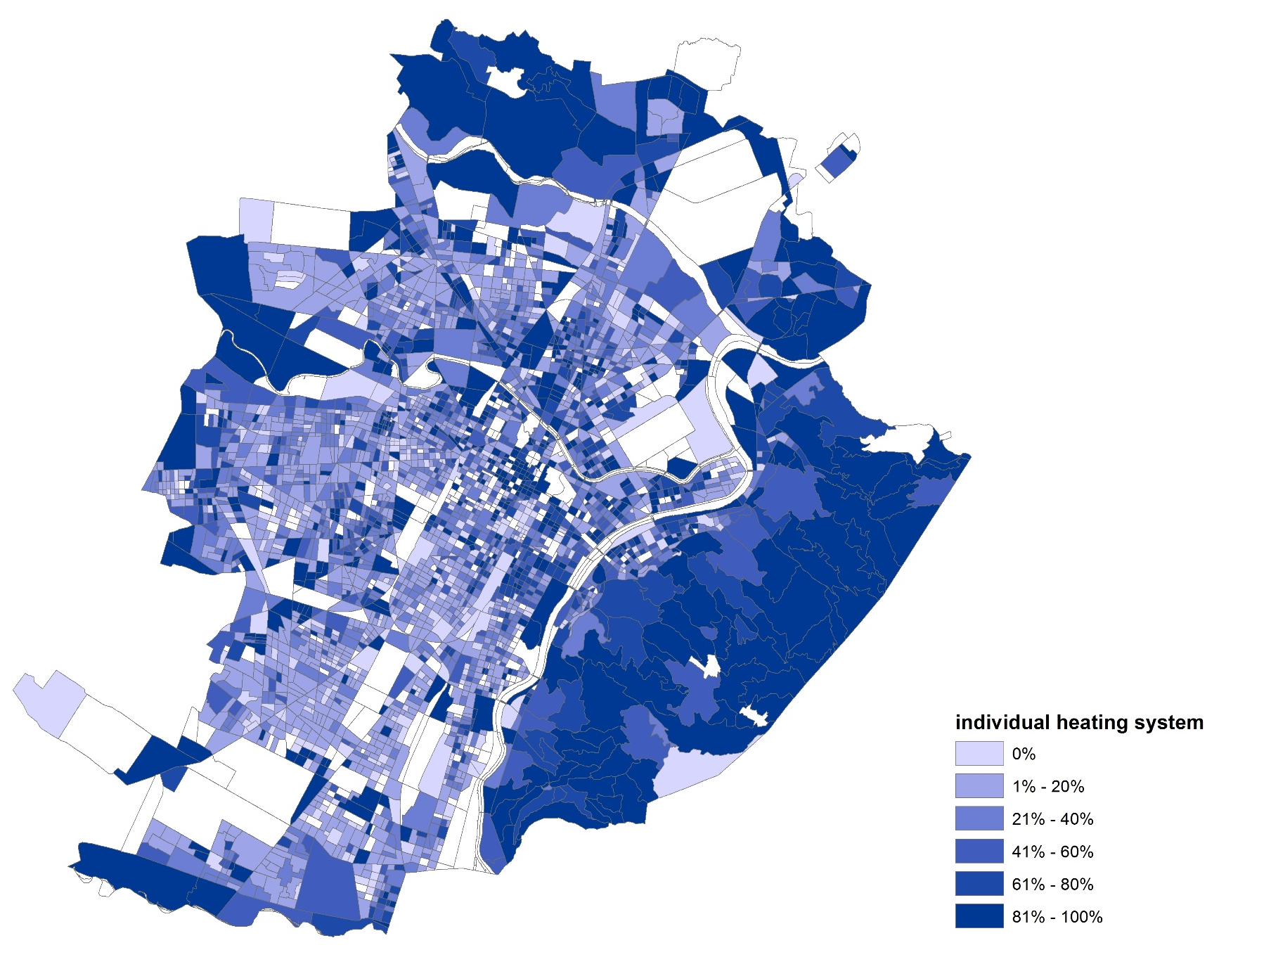
Result of hybrid energy mapping models

Slide 22
Existing energy systems
Energy data on hourly, seasonal and yearly basis
Heating and Cooling Demand and supply options
Input
Cadastry data - Climatic data – Spatial data
Municipalities and conurbations (buildings: use, occupancy, …)
Industrial zone (including heating and cooling consumption)
Heating and cooling demand points
Heating and cooling supply points
Transport data
Electrical data (networks, sources)
RES and Waste availability data
On economy
On users (including where possible DR)
On Regulation
On Managers & planners (technical and students)
On Air quality
On Citizen
On energy efficiency
On CO2 reduction
Impact
Future Hybrid Model
Mainly 2D
Different layers Different info for each layer
Different graphical representation of the open data based on the user
Simplified models
Integration with infrastructures
With already available tools for Mapping and Planning
With GIS, RES, nZEB
Transport map
Gas, Heat and Electricity distribution
Output
Energy savings
Financial investment
New ESCo services
Urban Planning
Energy Poverty Reduction
Models from building scale to district scale and to regional scale
Optimization of energy use
Definition of KPI at different levels
Reduction of CO2
Cost Benefit analisys
Innovative training methods
Open data
Social benefits analysis
Content
& Visualization
Integration

