Slide 1
Comparison of THREE ELECTRICAL SPACE HEATING SYSTEMS IN LOW ENERGY BUILDINGS FOR SMART LOAD MANAGEMENT
V. Lemort, S. Gendebien, F. Ransy and E. Georges
International Conference on SUSTAINABILITY & ENERGY ISSUES
Brussels, September 7th 2017

Slide 2
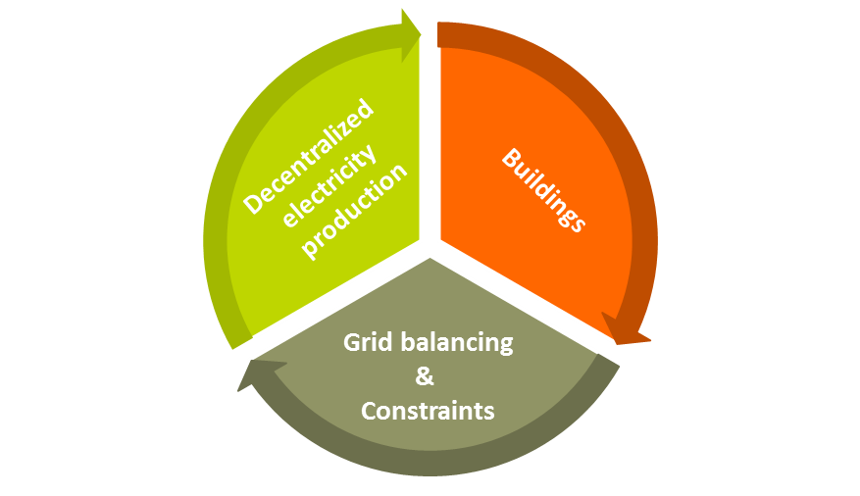

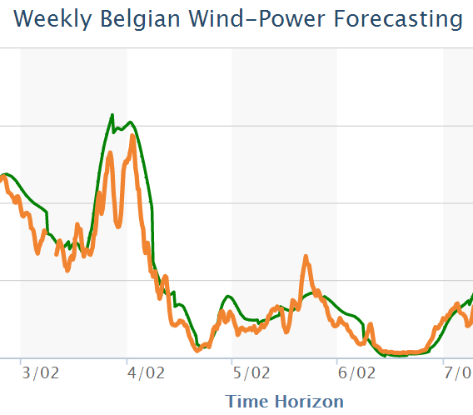
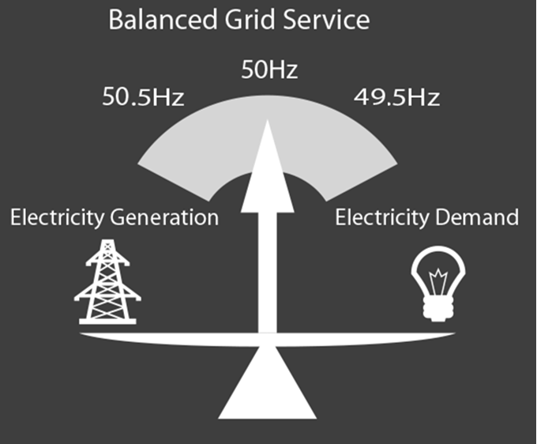
Introduction
Context
Intermittent production
1 nuclear
unit
DSM
Electrification
Heat pumps
Electric vehicles
Batteries
(Source: Elia)

Slide 3
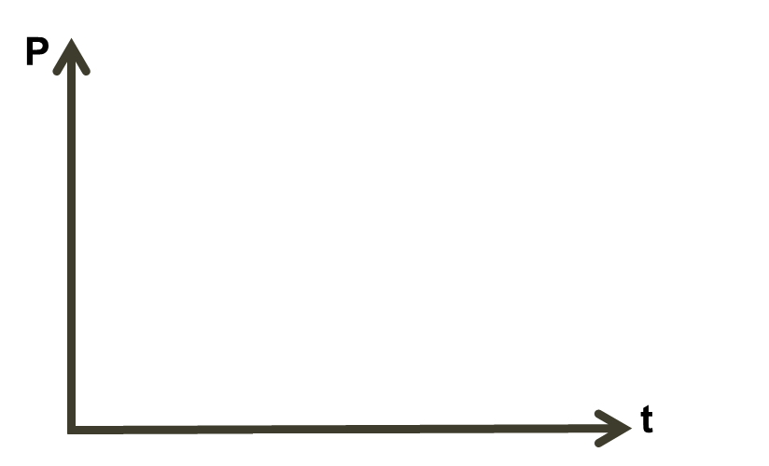
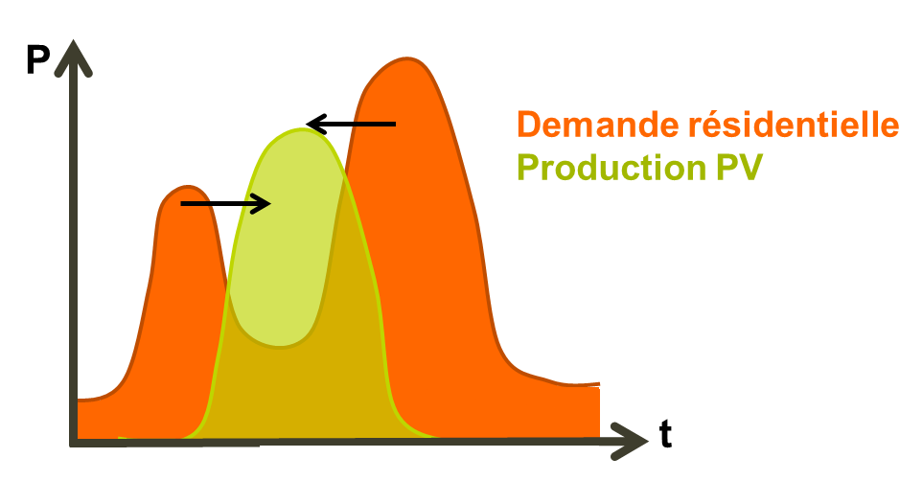
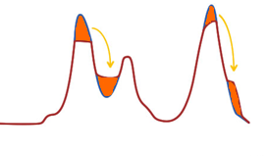
Introduction
Purpose of the study
  Compare the potential of load shifting of three heating systems: direct electric heaters, electric heaters with sensible storage, heat pumps with water tanks, in the frame of
    Peak shaving through load shifting
  Load matching through load shifting (self-consumption of PV production)

Slide 4
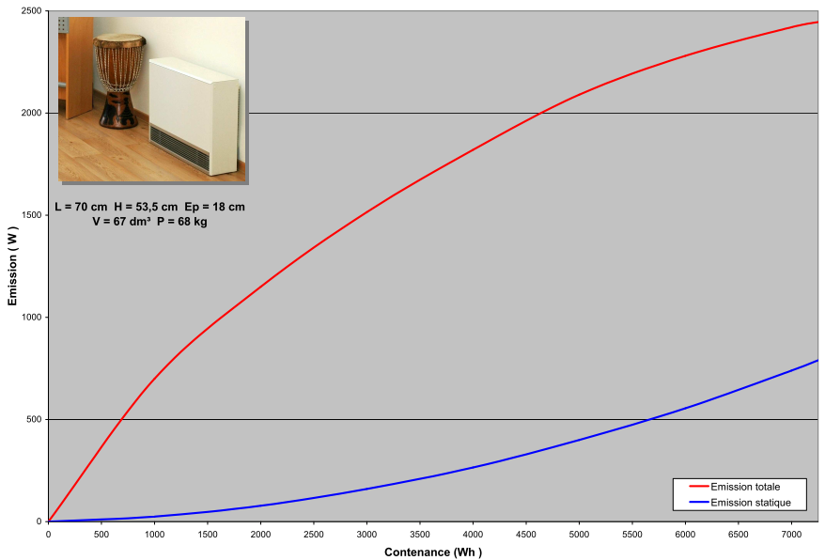

Introduction
Electric heaters with sensible storage

Slide 5
Content of the presentation
Introduction
    Context and objectives
    Electric heaters with sensible thermal storage
Case study and assumptions
    Building description
    Investigated heating systems
    Assumption
Potential of peak shaving
Potential of self-consumption
Conclusions

Slide 6
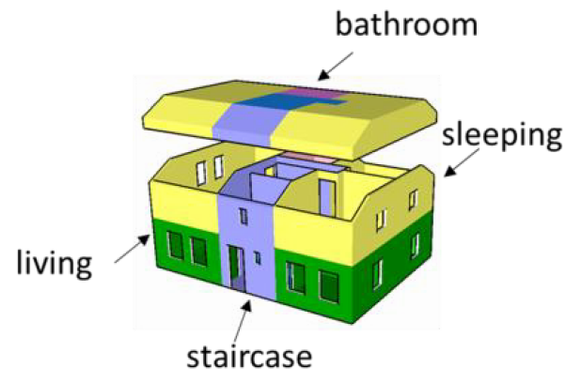
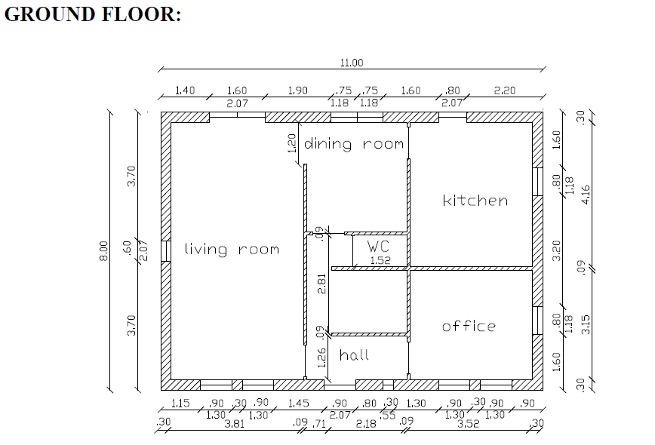
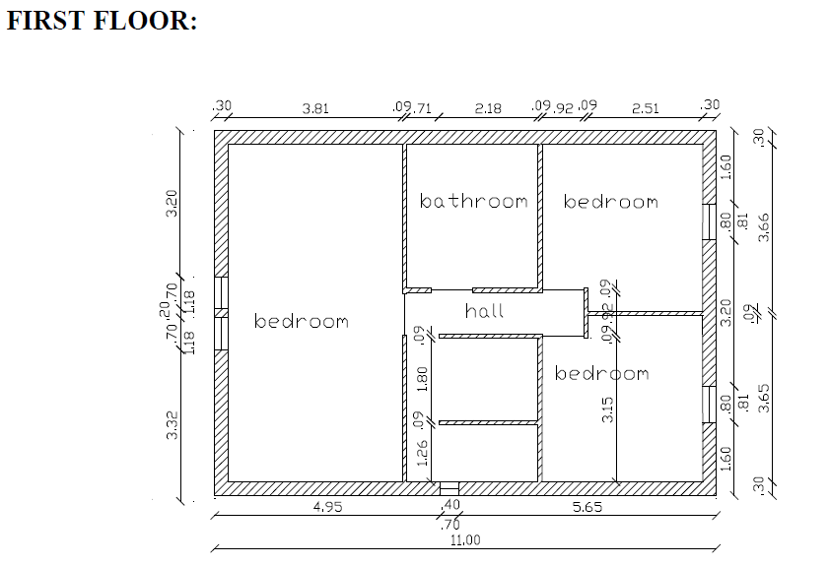
Case study and assumptions
Building description
  Detached house
  Massive structure
  External insulation
  Energy performance: K25
  Ground surface: 88 m²
  Heated volume: 457 m³
  Heated surface: 176 m²

Slide 7
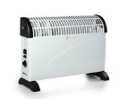
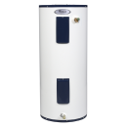

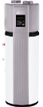
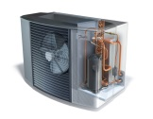

Case study and assumptions
Investigated systems
  Technologies?
  « Smart »?
    Peak shaving= prevent consumption during peak hours
    Self-consumption= maximum consumption during PV production period
Heating | Domestic hot water
Direct electric heaters | Electric water heater
Electric heaters with thermal storage | Electric water heater | Heat pump
Heat pump + water tanks

Slide 8

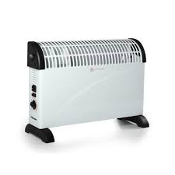
Case study and assumptions
Investigated systems
Smart?
Case 3
Case 5
+
+
Case 2
YES
Case 4
+
Case 6
+
+
Case 1
NO
+
DHW
DHW + space heating
Storage ?

Slide 9
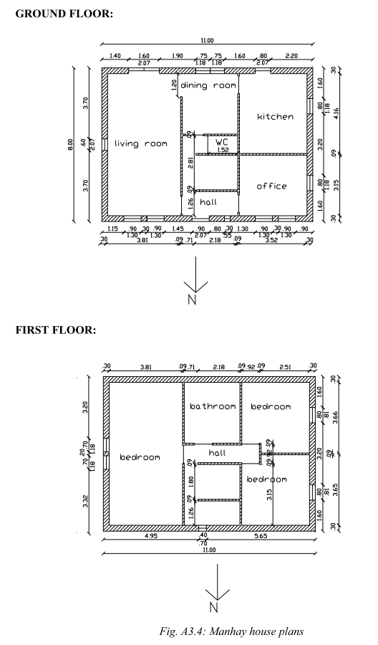
Case study and assumptions
Assumptions (sizing)
Emitters:
Heat pump: sized to cover 80% of peak heating load (at-10°C). Back-up electric resistances cover the remaining fraction.
1500-
1800 W
1000 W
1000 W
2 x
1000
-1800 W
1000
- 1800 W
1000 W

Slide 10
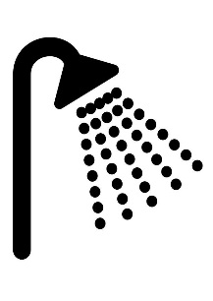
Case study and assumptions
Assumptions
200L
HEAT PUMP
Tap water
250L

Slide 11
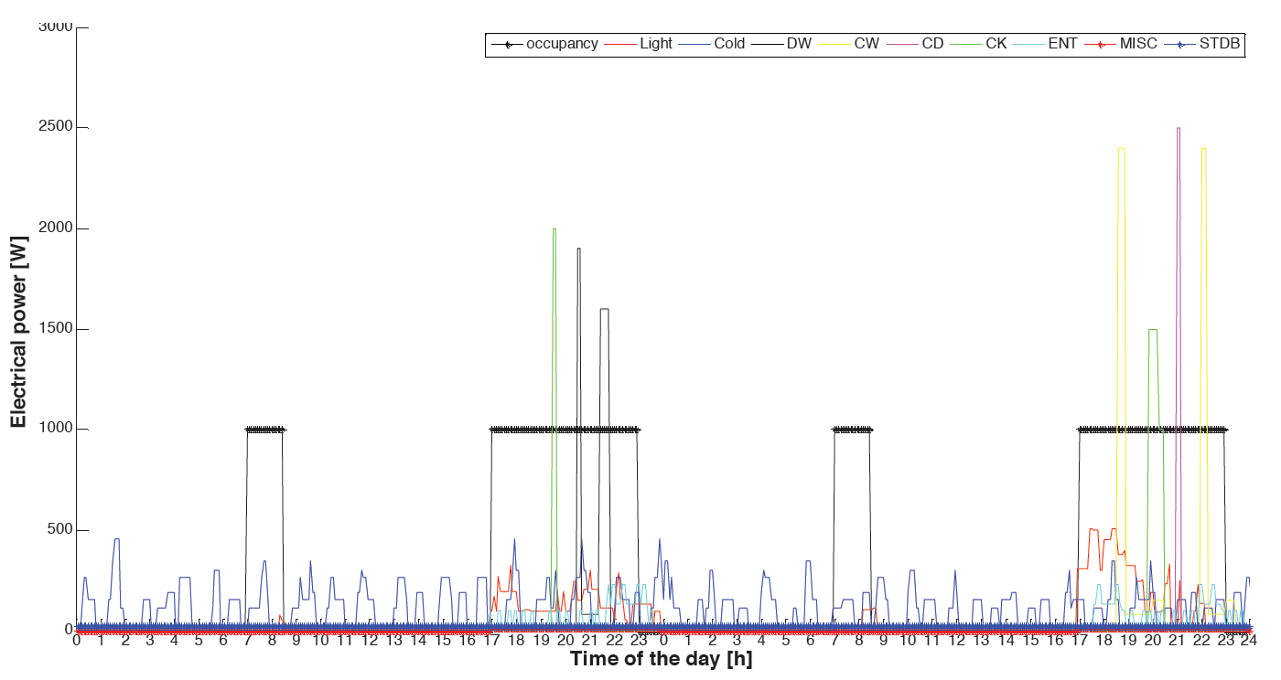
Case study and assumptions
Assumptions
Heat pump performance based on manufacturer data
Brussels climate (2012)
Decision time step: 5 minutes
Intermittent occupancy profiles: 7am-8:30am and 5pm-11pm

Slide 12
Content of the presentation
Introduction
    Context and objectives
    Electric heaters with sensible thermal storage
Case study and assumptions
    Building description
    Investigated heating systems
    Assumption
Potential of peak shaving
Potential of self-consumption
Conclusions

Slide 13
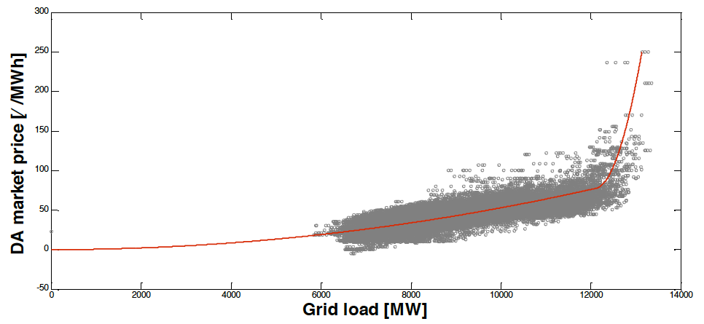
Potential of peak shaving
Context
  Daily peak electricity demand as function of average daily outdoor temperature
  Spot market price as function of grid load

Slide 14
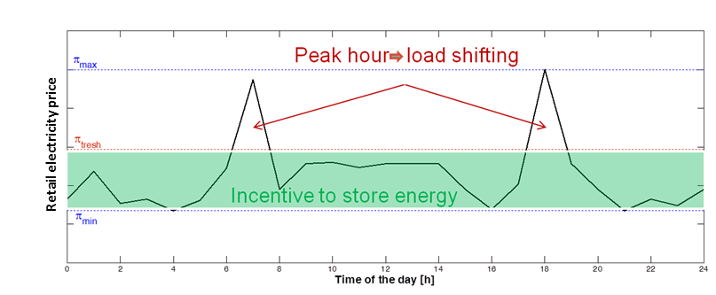
Potential of peak shaving
Control mechanism
The electricity price on the spot market is known one day ahead (N-1)
    For day N, a transition price ᴨ_{thres} is defined.
    Heat is stored when the price is lower than ᴨ_{thres}

Slide 15
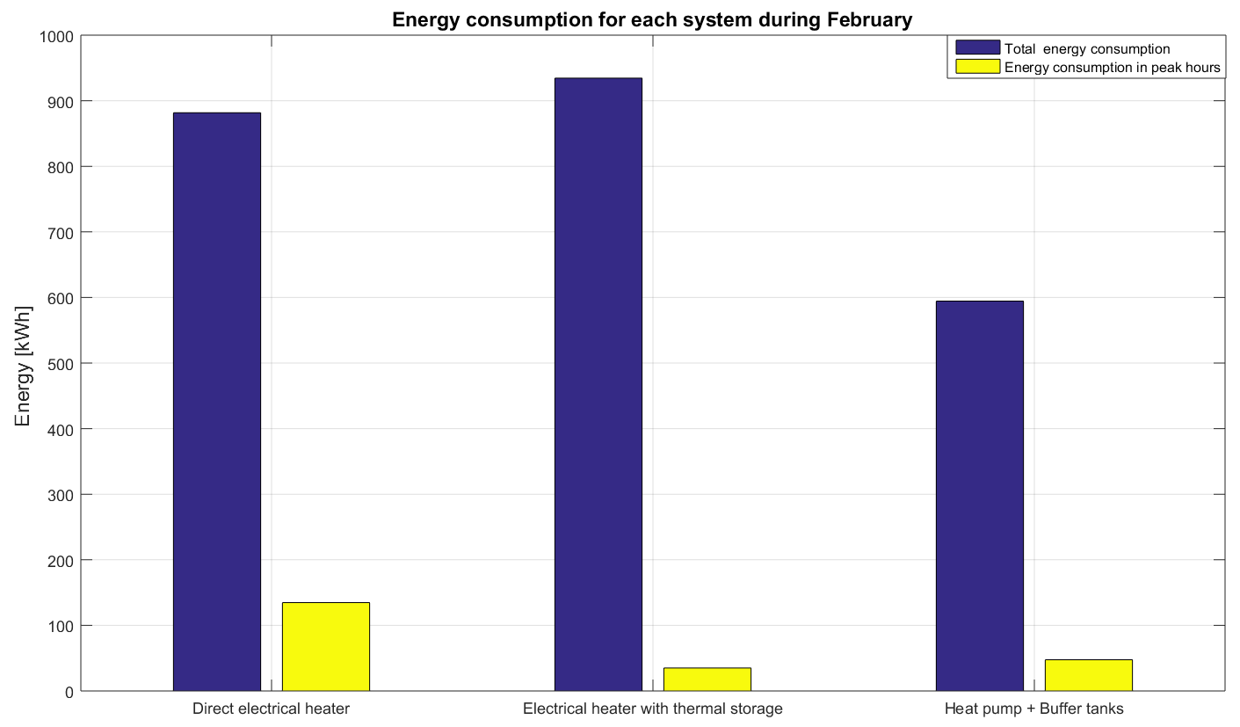
Potential of peak shaving
Results
more suitable for load shifting
Notes:
A slight overconsumption of the storage heaters compared to the direct electrical heater can be observed. This is mainly due to the static emission occurring during non-occupied hours (blue curve in Figure 6). The total amount of energy consumed during peak hours in February is 134 kWh for the direct electrical hours, 35 kWh for the storage heaters and 47 kWh for the heat pump coupled to buffer tanks. Relatively, storage heaters and heat pumps with buffer tanks seem to be suitable options for load shifting, compared to direct electrical heaters. However, conclusions regarding the load shifting related to the heat pump with buffer tanks are difficult to draw since they are highly dependent on the tank volume considered.

Slide 16
Content of the presentation
Introduction
    Context and objectives
    Electric heaters with sensible thermal storage
Case study and assumptions
    Building description
    Investigated heating systems
    Assumption
Potential of peak shaving
Potential of self-consumption
Conclusions

Slide 17
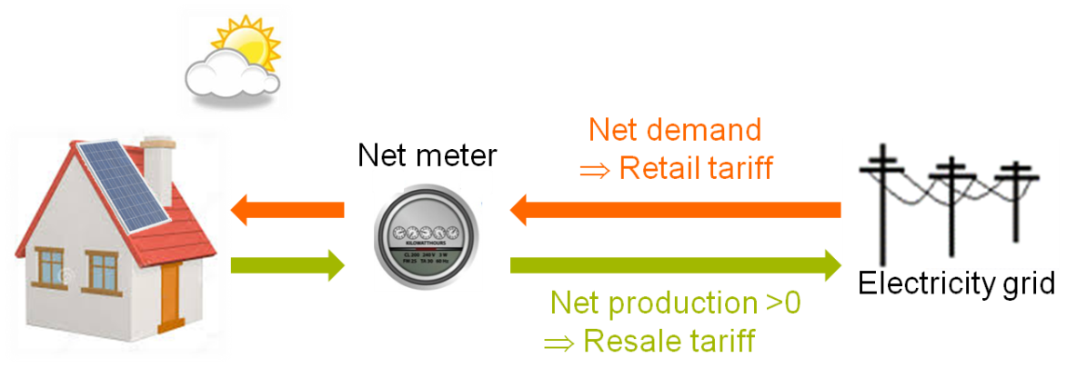
Potential of self-consumption
Context
Increase of number of “prosumers”
Electricity grid congestion and PV curtailment
Restrict the amount of distributed power supplied to the grid
Promote self-consumption by resale tariff < retail tariff
Today self-consumption is of the order of 24-31% (for a PV installation sized to provide 100% of annual appliances and lighting consumption)

Slide 18
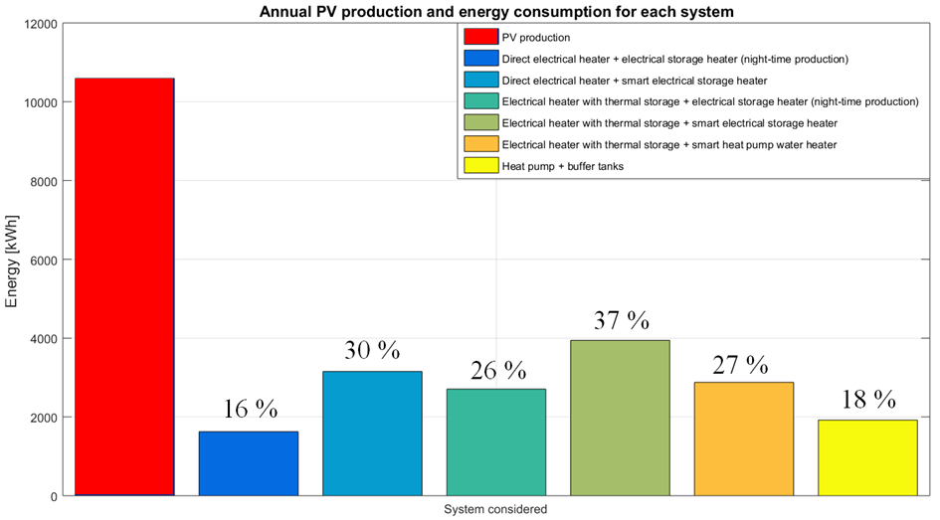
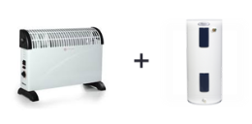
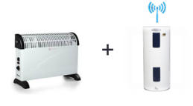

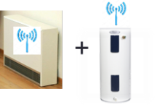
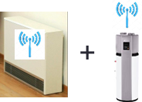
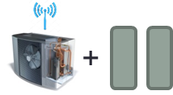
Potential of self-consumption
Results (self-consumption factor)

Slide 19
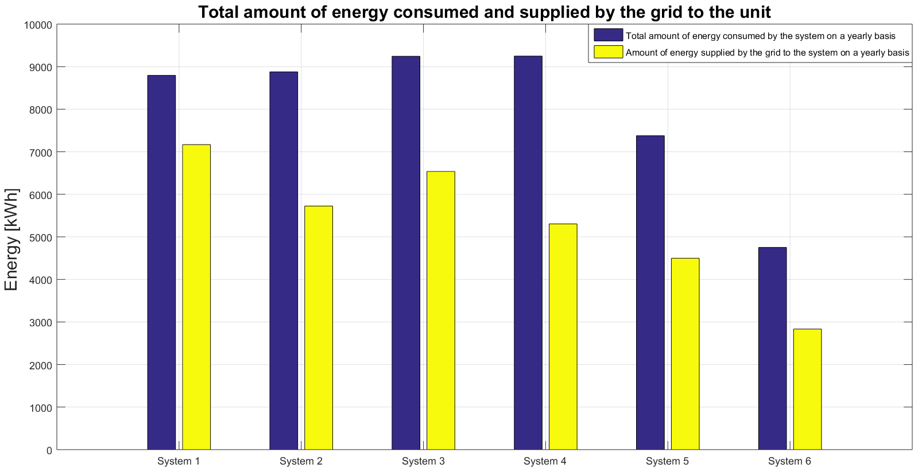
Potential of self-consumption
Results

Slide 20
Conclusions
Peak shaving
(Electric heaters + thermal storage) and (heat pumps + thermal storage) allow for a significant reduction of power consumed during peak hours
With (electric heaters + thermal storage), there is a slight over-consumption
Currently, no incentive to shift loads… but the situation might be critical with the electrification of the residential sector
Larger load shifting could be achieved with the heat pump if larger storage tanks were used. However, the total consumption would also increase. Hence, a economical optimization should be conducted.

Slide 21
Conclusions
Self-consumption
With an appropriate control, (electric heaters + thermal storage) allow for an increase of 20% points of self-consumption
(Heat pumps + thermal storage) show lower self-consumption, since better performance and hence lower consumption
Smart control of storage systems allow for a reduction of power supplied by the grid.

Slide 22
Thank you for your attention!
Vincent.lemort@ulg.ac.be

Slide 23
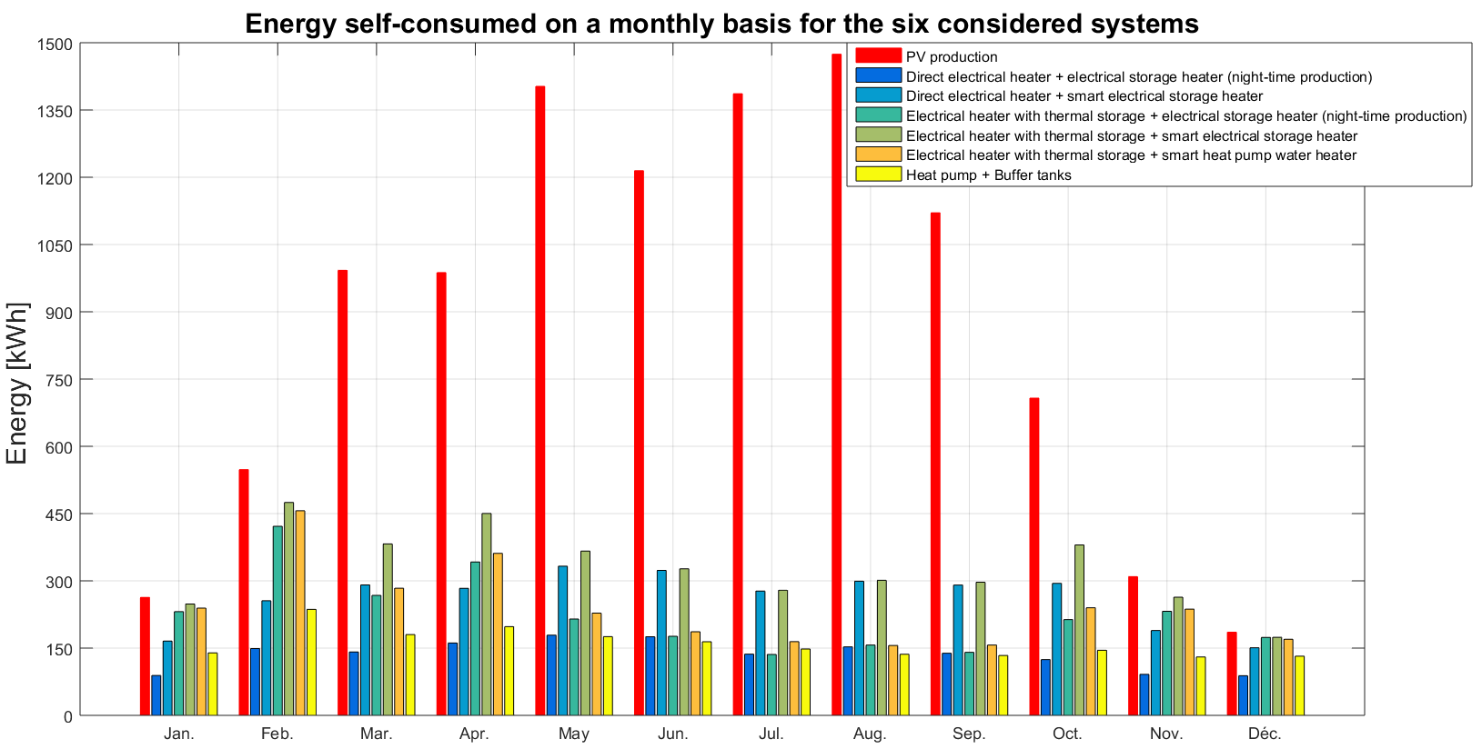
Potential of self-consumption
Results

