Slide 1
Energy Transition
The role of international collaboration and technology transfer
Bruxelles, 7 september 2017
Sergio La Motta

Slide 2
OUTLOOK
The energy transition driving forces .
What an energy transition is.
The UNFCCC Technology Mechanism .
The italian initiatives for technology transfer.

Slide 3
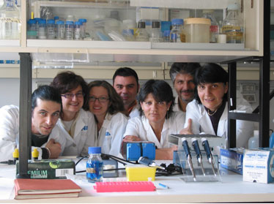

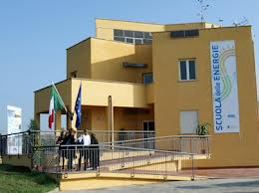
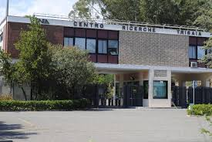
About ENEA
ENEA is the Italian National Agency for New Technologies, Energy and Sustainable Economic Development
It is a public RTO (Research and Technology Organization) operating in the fields of energy, the environment and new technologies to support the Country’s competitiveness and sustainable development
ENEA’s mission is to develop new technological solutions to meet the societal challenges, fostering transition to a low-carbon economy
The institutional mandate of the Agency is to disseminate and transfer knowledge, innovation and technology to industry, institutions and civil society at large

Slide 4
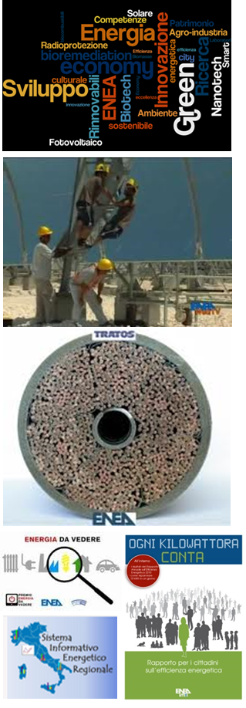
Activities
ENEA’s activities span many fronts ranging from basic to applied research and innovation:
Research: Basic, mission-oriented, applied and industrial research, also through the development of prototypes and product industrialization
Technology Transfer: Dissemination and transfer of research results to industry and public administrations, and exploitation for production purposes
Advanced services: Studies, measurements, tests and assessments tailored to both public and private bodies and enterprises
Training and information: Activities aimed at broadening sector expertise and public knowledge and awareness

Slide 5
Research Facilities and Staff
Research facilities
9 Research Centres
5 Research Laboratories
13 Territorial offices
Brussels Liaison Office
Headquarters in Rome
Human Resources
(as of 30.06.2016)
2514 permanent staff:
36% women
59% graduates

Slide 6
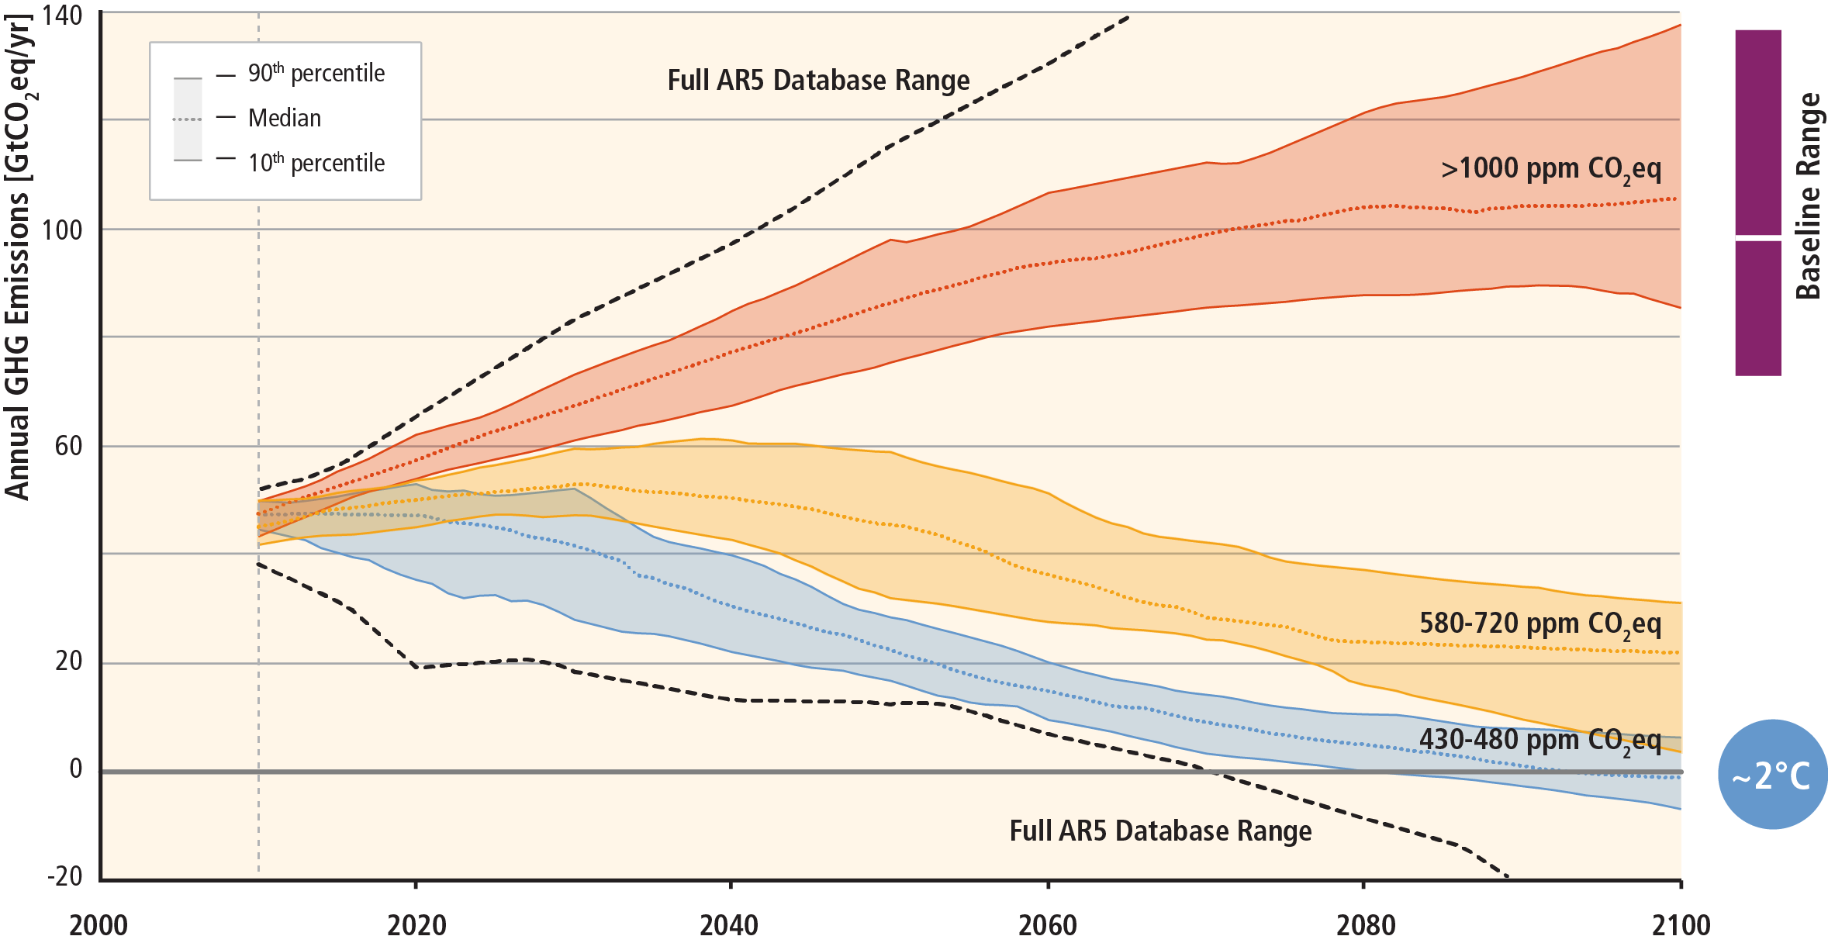
Need for a transition
40-70% reduction

Slide 7
What a transition really is

Slide 8
What a transition really is

Slide 9
3 E’s of Sound Energy Policy
Energy Security
Promote diversity, efficiency and flexibility within the energy of countries. Remain prepared collectively to respond to energy emergencies. Expand international cooperation with all global players in the energy markets.
Environmental Protection
Enhance awareness of options for addressing the climate change challenge. Promote greenhouse gas emission abatement, through enhanced energy efficiency and the use of cleaner fossil fuels. Develop more environmentally acceptable energy options.
Economic Growth
Ensure the stable supply of energy to countries and promote free markets in order to foster economic growth.

Slide 10
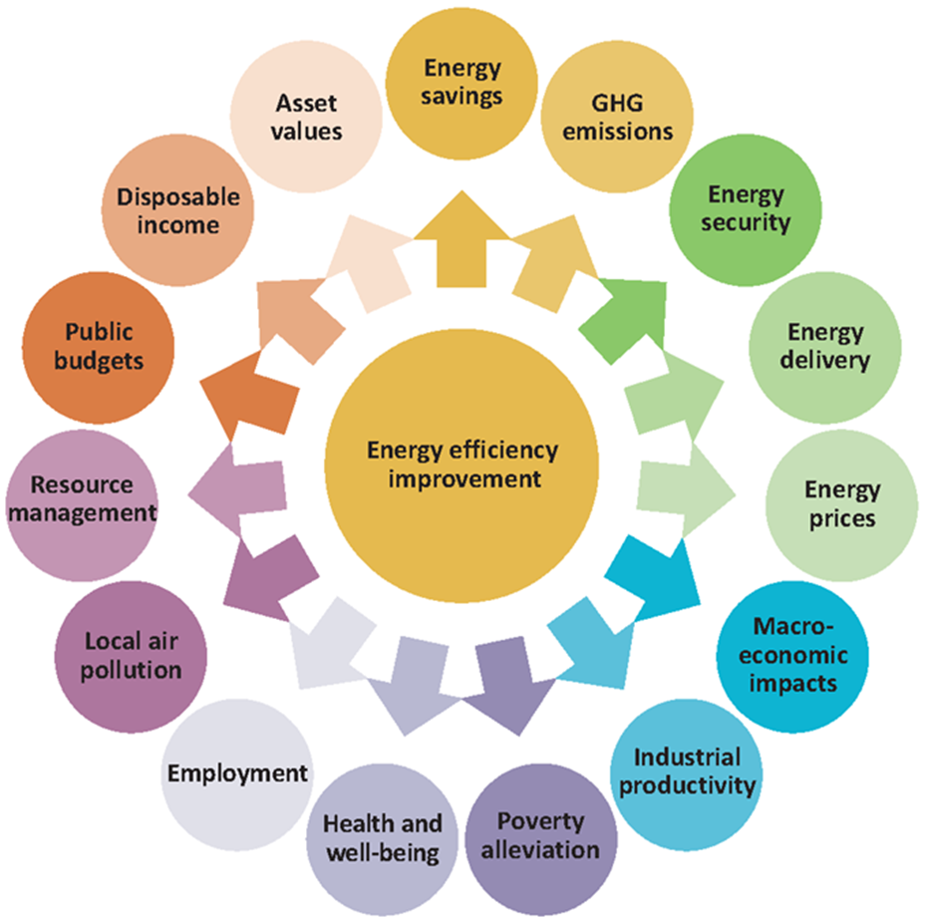
Generate multiple benefits

Slide 11
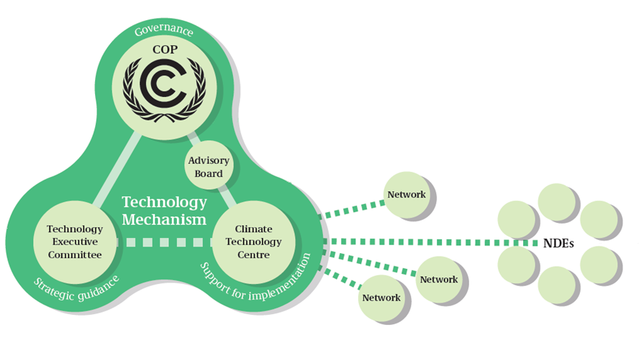
The Technology Mechanism

Slide 12

CTCN Mandate, Services and Structure
Mandate
CTCN mission is “Stimulating technology cooperation and enhance the development and transfer of technologies to developing country Parties at their request”
Services:
Technical assistance to developing countries
Knowledge sharing and training
Fostering collaboration on climate technologies (including linking climate technology projects with financing opportunity”)
Structure:
CTCN hosted by UNEP in collaboration with UNIDO and supported by 11 partner institutions with expertise in climate technologies

Slide 13
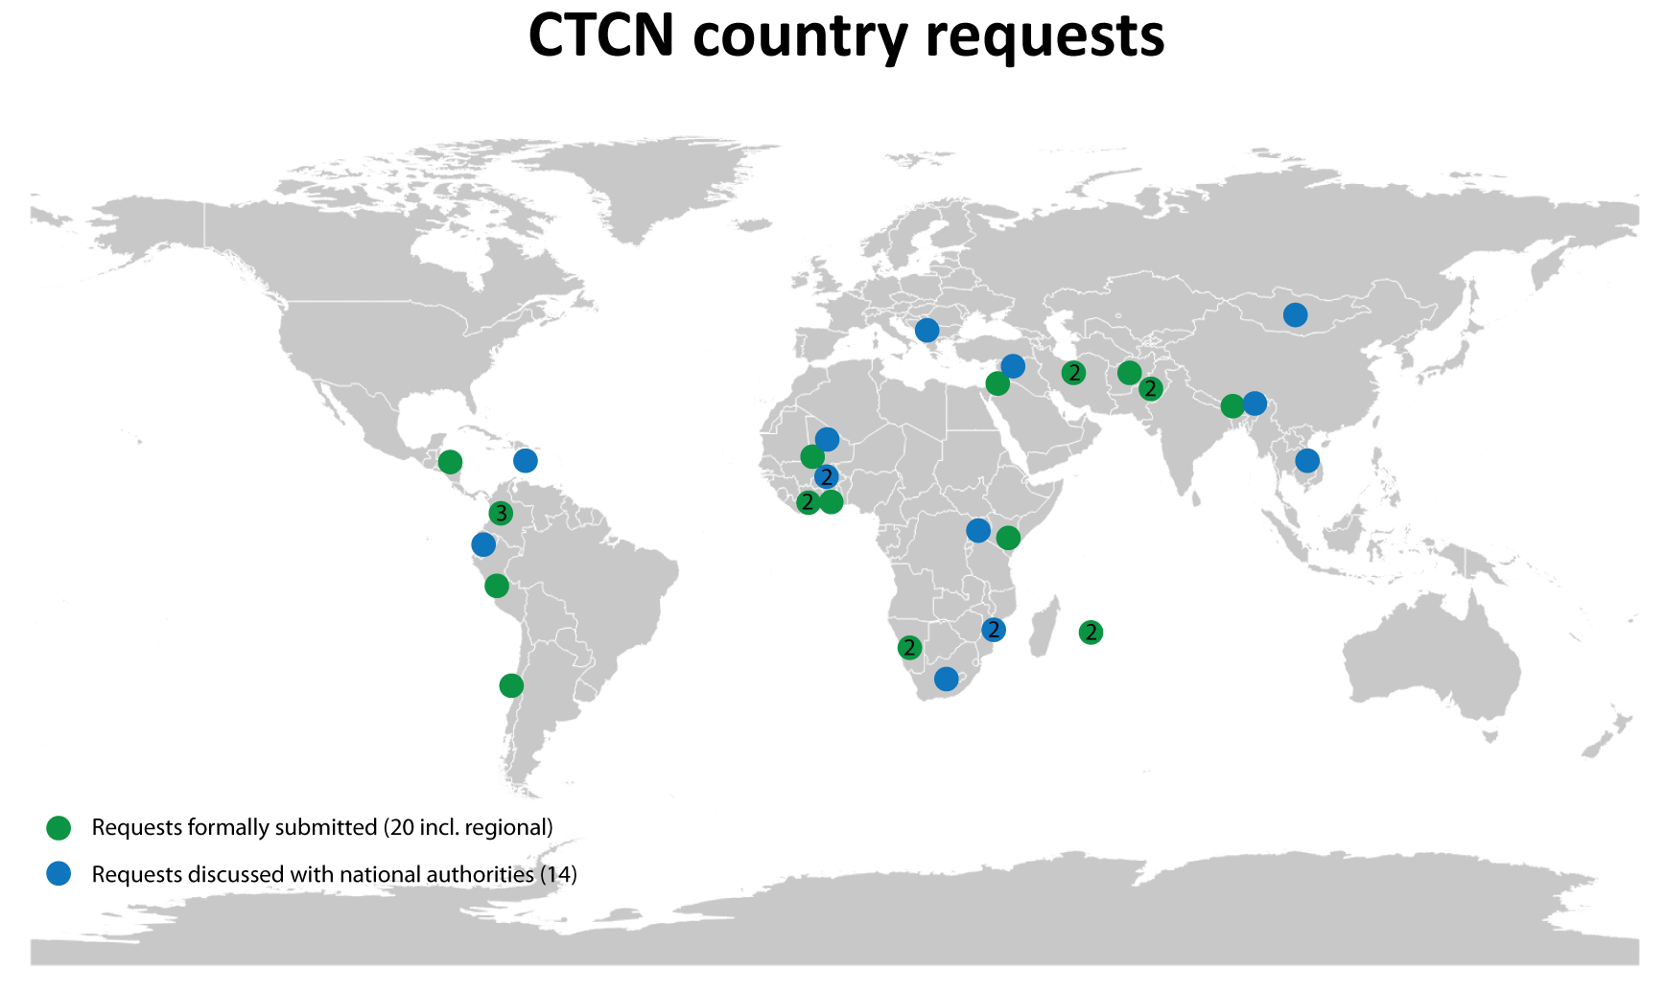
CTCN Technical Assistance

Slide 14
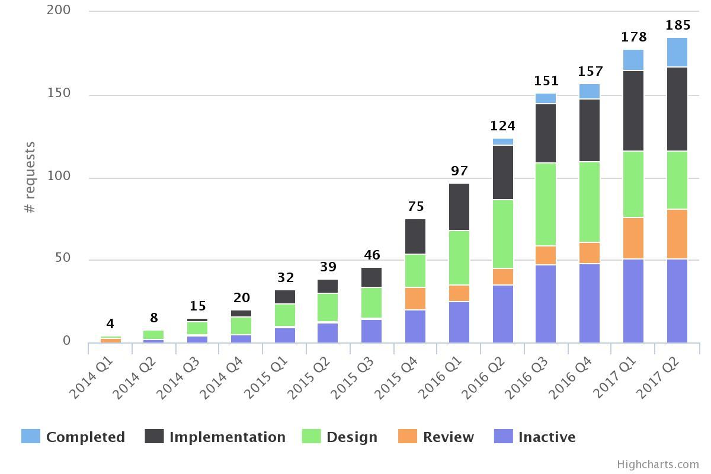
CTCN Technical Assistance
Technical Requests by Developing Counbtries

Slide 15
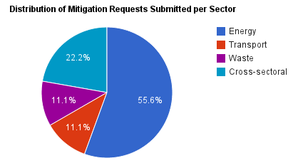
CTCN Technical Assistance
Mitigation Requests by Sector

Slide 16
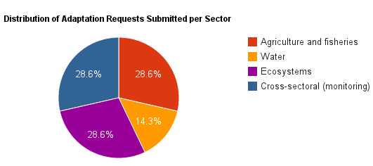
CTCN Technical Assistance
Adaptation Requests by Sector

Slide 17
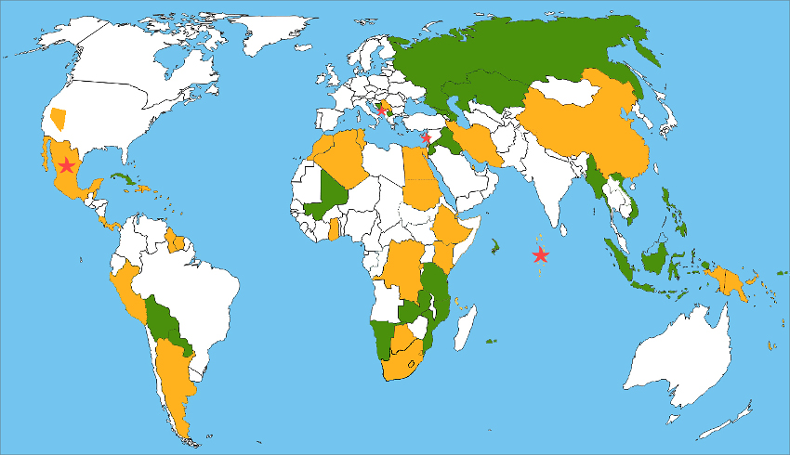
Bilateral initiatives by IMELS

Slide 18
CONCLUSIONS
A TRANSITION IMPLIES NOT ONLY A TECHNOLOGY BUT ALSO A CULTURAL CHANGE AND A CHANGE IN THE SET OF VALUES OF A COMMUNITY;
DEVELOPING COUNTRIES ARE TODAY PRIMARY ACTORS AND ARE A CHALLEGE AND AN OPPORTUNITY;
TO ENHANCE THE TRANSITION TOWARDS LCS, INDUSTRIALISED COUNTRIES NEED TO ACT WITHIN THEIR BORDERS AND TOWARDS DEVELOPING COUNTRIES;
TECHNOLOGY TRANSFER AND COOPERATION WITHIN LCS TRANSITION IS APPROACHED IN MANY DIFFERENT WAYS: BILATERAL, MULTILATERAL, NORD-SUD AND SUD-SUD AND ALSO SUD-NORD (FRUGAL INNOVATION ESPLECIALLY IN THE CIRCULAR ECONOMY FRAME).

