Slide 1
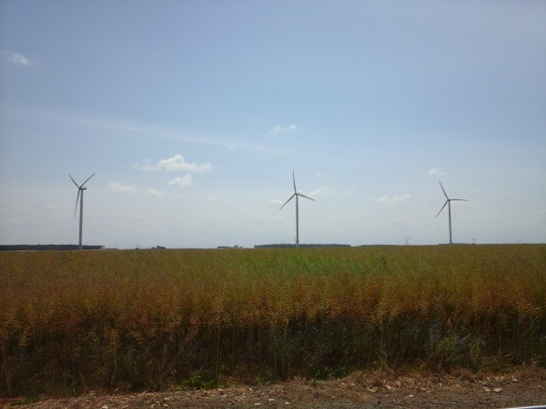
Crowdfunding wind farms in Champagne Berrichonne: towards acceptability of facilities?
2nd Geoprogress Global Forum
Parc éolien de St-Georges-sur-Arnon (Indre)
Cliché : R. Garcia, 2015
Romain Garcia, PhD student in géography
Supervisor: F. Ardillier-Carras, Professor of geography
CEDETE Laboratory, University of Orleans

Slide 2
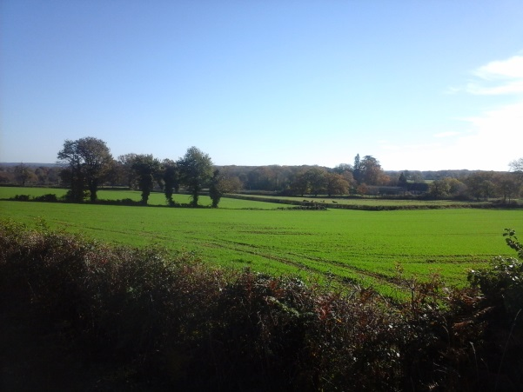
Wind development in rural areas
Dynamic wind development for 15 years in France, which has led to a change in rural areas (the appearance of agro-energy landscapes, conflicts of use in particular);
Acceptability is a "process of political evaluation of a project that interacts with a plurality of actors and on the basis of which ... institutional rules are recognized as legitimate" (Fortin, 2013).
Virgin windmill landscape, Tilly, Indre
R. Garcia, 2015

Slide 3
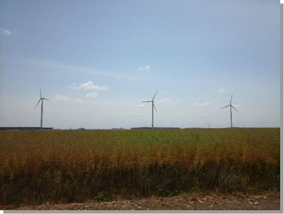
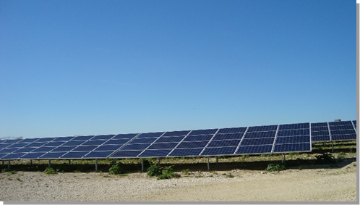
Wind power in Champagne Berrichonne
Since 2009, the landscape has evolved with the installation of the first wind turbines in the territory. This wind development has continued quite significantly in northern Champagne Berrichonne: nowadays a true agroenergy landscape is visible.
Photos n ° 1 and 2: Agroenergy landscape in Champagne-Berrichonne (Saint-Georges-sur-Arnon and Issoudun)

Slide 4
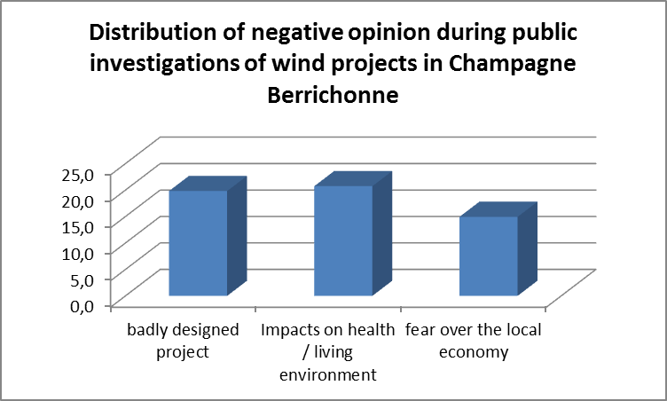
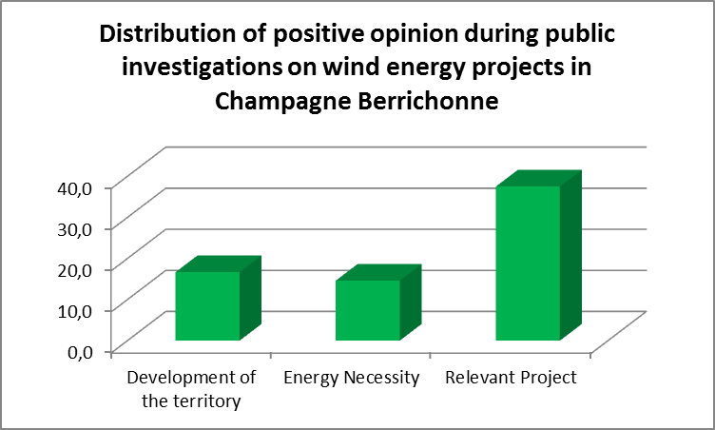
Opinions about wind development in Champagne berrichone

Slide 5
Saint-Georges-sur-Arnon, a participative project accepted by citizens
The opposition is limited on the wind in the commune despite some doubts on the sector;
The development has been achieved with relatively good information to the public;
The wind farm built in 2009 allows residents to invest in them and receive dividends, which are tied to the production of wind turbines;
It seems that the process of financial participation of the residents makes it possible to reduce the opposition.

Slide 6
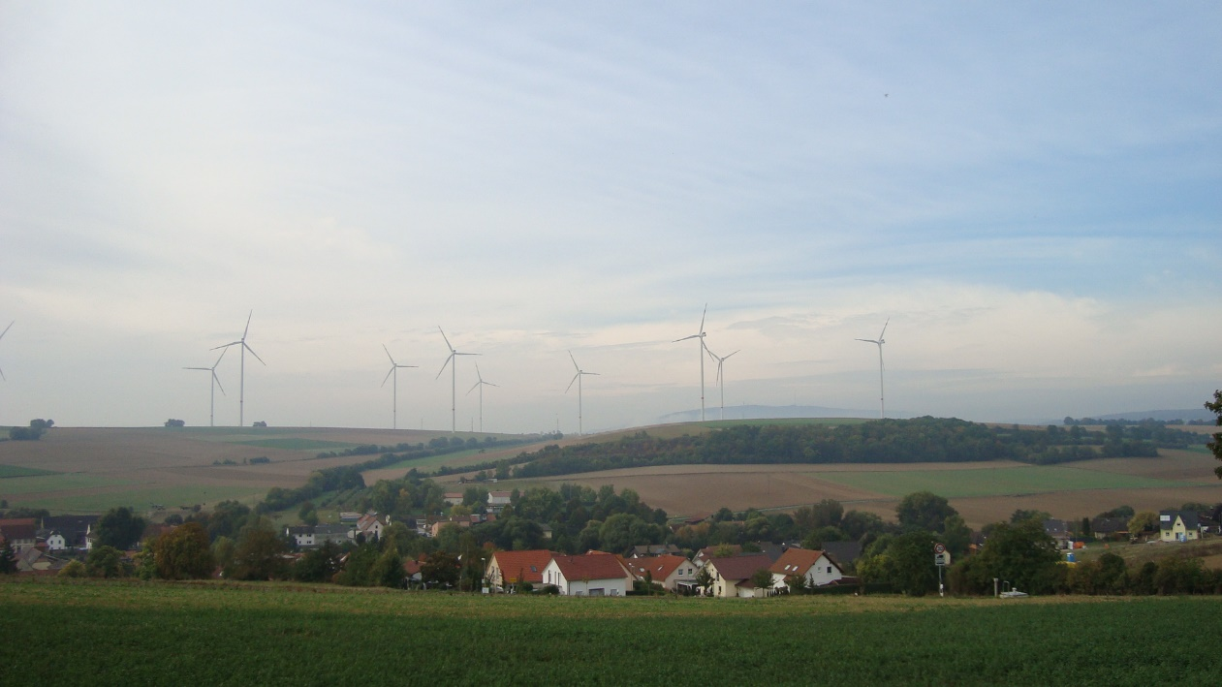
Thank you
Wörrstatd (Germany). R. Garcia, 2016
Romain Garcia
rgarcia.geo@gmail.com
2nd Geoprogress Global Forum

