Slide 1


Preliminary analysis of the potential benefit of thermoregulation systems and individual metering of heat consumptions in the Italian residential building stock
I. Bertini, L. Canale, M. Dell’Isola, B. Di Pietra, G. Ficco, G.Puglisi
2nd GGF Intern. Conf. on "Sustainability and Energy Issues" - Brussels, September 7th, 2017
Eng. Biagio Di Pietra
www.efficienzaenergetica.enea.it

Slide 2
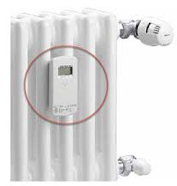

Aim of the study
The purpose of this study is to evaluate the potential energy savings resulting from the transposition in Italy of the article 9 of Energy Efficiency directive (2012/27/EU) concerning the introduction of consumption-based cost allocation of heating, cooling and hot water in multi-unit buildings supplied from collective systems .
This requirement was introduced in Italy from June 30,2017 according to Legislative Decree 4th July 2014, n. 102 and subsequent amendments and integrations.
The study was carred out in collaboration with University of Cassino in the framework of the Electrical System Research Program funded by the Ministry of Economic Development

Slide 3
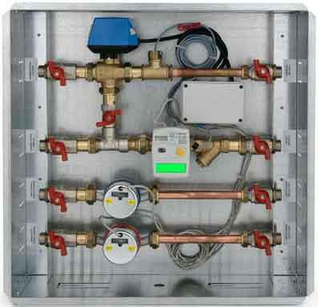
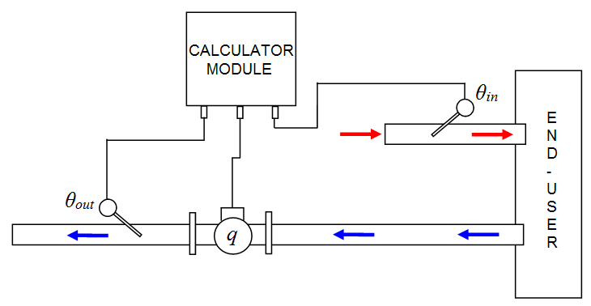
Art.9 - LD 4th July 2014, n. 102
Individual heat metering and billing of energy consumption
As regards end-customers living in multi-apartment or multi-purpose buildings, supplied by an district heating or a common source, are obliged to install individual heat meter for heating/cooling and DHW for each apartment or unit, where technically feasible, efficient in terms of costs and proportionate to the potential energy savings according to UNI EN 15459

Slide 4
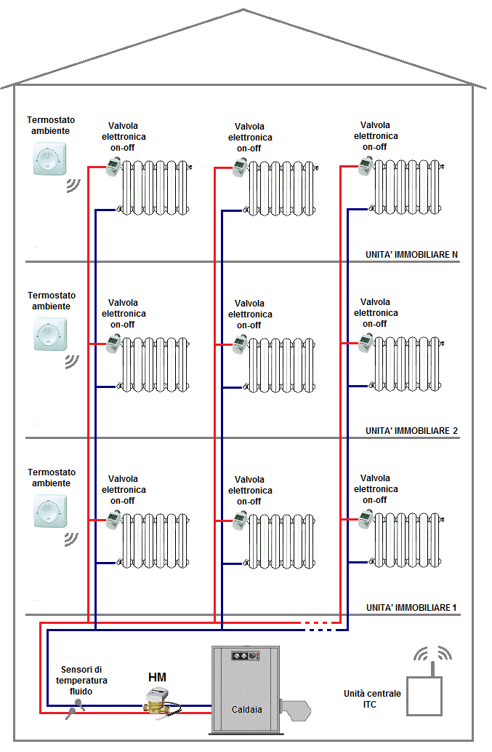
Art.9 - LD 4th July 2014, n. 102
In buildings where the use of heat meters is not technically feasible or cost-efficient, individual heat cost allocators and thermoregulations systems must be installed on each heating element in the individual units of multi apartments or multi purpose buildings supplied from a common source,
except where it is demonstrated that installing these systems is not cost-effective according to UNI EN 15459

Slide 5

Assessment of expected energy benefit of heat cost allocator
the expected benefits of installing individual heat meters change from 8 to 40 % according to several studies conducted in different EU Member States . Unfortunately, specific studies regarding the Italian territory and the Mediterranean climate conditions are still lacking.
In order to assess the expected energy benefits, primary energy for space heating
of 15 multi apartments located in two regions was investigated. (Turin and Rome).

Slide 6
Assessment of expected energy benefit of heat cost allocator
The gas consumption for space heating of buildings has been investigated during 2 heating seasons: before and after the installation of the heat cost allocators and thermoregulation systems; these one has been normalized with respect to actual degree day (DD).
The results show a very variable benefit for each building
Average benefit is about 8% in the first year
Anyway, monitoring is in progress to allow for a better estimate of the actual benefit also in the second and third year

Slide 7
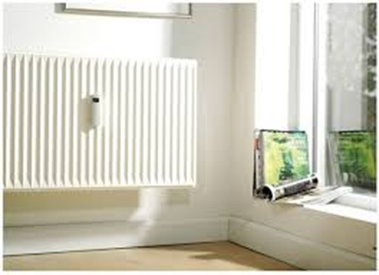
Italian residential building stock
The present study evaluates the potential benefit of individual heat cost allocators (HCA) and thermoregulations (TR) systems installed in the Italian residential building stock supplied from a common source, where these systems are cost efficient
For this porpose
ISTAT census (2011) was analyzed on a regional basis identifying: Number and category of building (mono, multy family building), typology of heating systems (i.e. central or independent heating system).
reference buildings have been characterised for 9 construction periods and for 6 occupancy categories (from 2 to 30 units per building) at regional level
number of multi-unit buildings and dwiling required to install individual HCA and TR systems (according to LD 102/2014) have been estimated at regional level
primary energy for space heating has been estimated for regional residential building stock and for buildings required to install heat cost allocator

Slide 8
Italian residential building stock
Italian residential building stock has been analyzed through both the ISTAT census 2011 and a recent statistical analysis performed by ENEA based on ISTAT data.
About 64% of Italian dwellings is part of a multifamily buildings (i.e. a bulding with 3 or more housing unit), while the remaining share is equally distributed between the single/two-family building categories

Slide 9
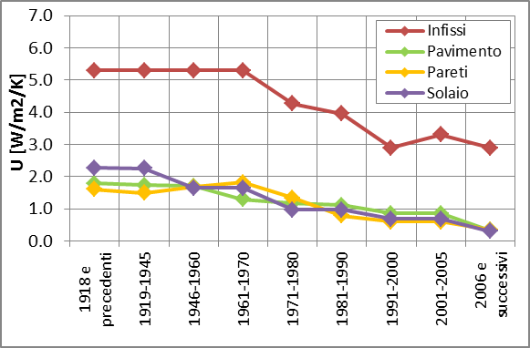
Building envelope features of residential building stock
Thermal transmittance of the building envelope has been analyzed for different constructive age according to TABULA project (Politecnico di Torino), which identifies the national construction types and the relevant period of greater diffusion for the climatic zone E
For the purpose of this study, such constructive typologies have been considered representative throughout the national territory.

Slide 10
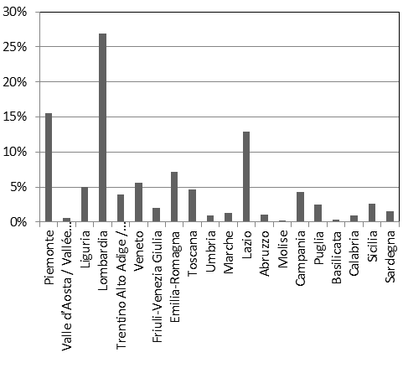
Heating systems features
According to ISTAT census, centralized systems are about 18% of the total thermal systems installed in Italian residential buildings.
About 55% of total central heating plants are located in three regions (Piemonte, Lombardia e Lazio). The regions with the highest incidence of centralised plants are : Piemonte, Trentino, V.D’Aosta, Lombardia

Slide 11
Primary energy demand for space heating
Primary energy for space heating of the Italian residential building stock has been estimated under standard conditions according to simplified method of Ministerial Decree 26/06/2009
Simplified example of the spreadsheet implemented to estimate regional primary energy demand for each building category and for each construction age

Slide 12
Potential energy saving in Italian building stock
The primary energy demand for space heating of residential Italian building stock amount to about 20.4 Mtoe
In order to estimate the impact of buildings obligated to install heat meter systems, regional consumption was filtered using the following data:
Number of building with central heating systems, (processing data of Istat census )
Number of multi-family buildings(excluding single-family house), (processing by Istat census)
Building class, in which individual heat cost allocators are cost-efficient (according to UNI EN 15459)

Slide 13
class of buildings potentially subject to individual heat metering
two building classes were defined according to the economic analysis of Italian Authority of Energy (AEEGSi document DCO 252/2016/R/TLR) as follows
viable building class, primary energy demand for space heating more than 150 kWh/mq*year, in which buildings are required to install HCA and TR system
exempt building class, primary energy demand for space heating less than 80 kWh/mq*year , in which no building are required to install HCA an TR system
In this study two scenario have been analyzed
Scenario A combines a benefit of 20% to buildings with primary energy consumption more than 80 kWh/m2/year
Scenario B combines benefit of 10% with viable building class

Slide 14
Potential benefit of thermoregulation and individual heat metering: Results of the study
Scenario A:
energy consumption for space heating of multi family buildings required to install HCA and TR system is about 21% of total heating consumption of residential building stock
potential benefit is about 4% of total residential consumption for space heating
regions with the greatest potential benefits: Piemonte (7.5% of regional consumption for space heating), Trentino Alto Adige 9%, Lombardia 6%
Scenario B:
- energy consumption for space heating about 13% of total heating consumption of residential building stock
Expected benefit of individual heat meters is about 1,3 % of consumption for space heating

Slide 15
Thanks for your attention!
biagio.dipietra@enea.it

