Slide 1
2nd Geo progress Global Forum International Conference on
Sustainability and Energy Issues
September 7th, 2017 Brussels
Regione Veneto, Av. de Tervueren, 67 1040 Brussels
“Does sustainability need international co-operation?”
Dario Chello, President of MEDENER

Slide 2
Contents
Short presentation of MEDENER
Why has the Trump's new presidency first act been
the withdrawal of the United States from the Paris Agreement?
Is it possible to operate the energy transition in the Mediterranean region by acting bilaterally on the energy issue as self-consistent matter?
Conclusions and recommendations

Slide 3
Section 1:MEDENER
Established in 1997 (April 11th) as an international non-profit organisation, it brings together 12 national energy agencies from both northern and southern shores of the Mediterranean
Since November 14th, 2016 two new observer members have joined the Association:
MALTA and MAURITANIA

Slide 4
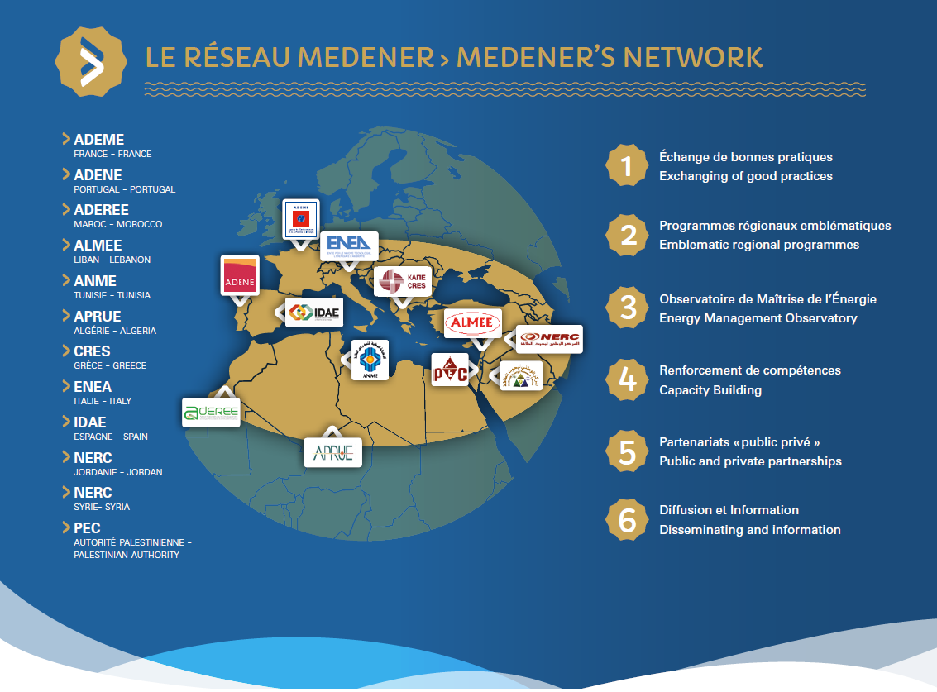

Slide 5

On April 11th, 2017 MEDENER celebrated its 20th birthday

Slide 6
Section 2:
Why has the Trump's new presidency first act been the withdrawal of the United States from the Paris Agreement?

Slide 7
June, 01, 2017, The White House Office of the Press Secretary https://www.whitehouse.gov/the-press-office/2017/06/01/statement-president-trump-paris-climate-accord
As President, I can put no other consideration before the wellbeing of American citizens. The Paris Climate Accord is simply the latest example of Washington entering into an agreement that disadvantages the United States to the exclusive benefit of other countries, leaving American workers -- who I love -- and taxpayers to absorb the cost in terms of lost jobs, lower wages, shuttered factories, and vastly diminished economic production.
Thus, as of today, the United States will cease all implementation of the non-binding Paris Accord and the draconian financial and economic burdens the agreement imposes on our country. This includes ending the implementation of the nationally determined contribution and, very importantly, the Green Climate Fund, which is costing the United States a vast fortune.
Compliance with the terms of the Paris Accord and the onerous energy restrictions it has placed on the United States could cost America as much as 2.7 million lost jobs by 2025 according to the National Economic Research Associates.

Slide 8
Renewables 2017 Global Status Report – Paris, REN21 Secretariat

Slide 9
Renewables 2017 Global Status Report – Paris, REN21 Secretariat

Slide 10
Cumulative primary energy savings since 1990 are 13 EJ (Figure 3.14)

Slide 11
Mrs May’s battle cry of “No deal is better than a bad deal” has already been abandoned, after the election defeat (Gilles Merritt – Friends of Europe)
So, if the policy you want to implement is to go back in the direction of the State-Nation, you must first deny any cross cutting and complex problem and, consequently, any attempt for a global approach to governance.

Slide 12
Section 3:
Is it possible to operate the energy transition in the Mediterranean region by acting bilaterally on the energy issue as self-consistent matter?
More than 30 years ago Hans H. Landsberg and his colleagues of the Resources for the Future (Washington) have clearly explained the reasons against the Energy Independency of State Nation, in their “Energy Today and Tomorrow: Living with Uncertainty”

Slide 13
“Migration, environment and climate change: Evidence for policy” (MECLEP)
The preliminary results of the MECLEP project, founded by European Union and implemented by the International Organization for Migration (IOM), finds that migration can be a positive adaptation strategy.

Slide 14
Section 4:
Conclusions and recommendations

Slide 15
Conclusions
To sum up, we have to face two relevant global problems within the Mediterranean Region: at first Climate Change and Migration as the second, although often they can interfere each other.
We consider also that Energy Transition could be a powerful multipurpose political approach which can fit both the two global problems.
There is a consensus in the EU institutions in considering the Renewable Energy Sources and Energy Efficiency a priority, once more in a broader, global approach.

Slide 16
Recommendations
We need to establish partnership policies with countries on the southern shore of the Mediterranean and Africa that involve these countries in concrete projects.
Direct financial aid to governments in these countries is to be avoided.
Likewise claiming that our best practices in the sector should be adopted sic et simpliciter by the countries benefiting from the co-operation, is an attitude we cannot follow any more.
Our approach should not retrace step by step the same path followed in Europe from the nationalization of the energy system to its liberalization.
The three UfM thematic Platforms have to work together in close collaboration, in order to enable cost-effective technological solutions within an adequate legislative and regulamentary energy framework.

Slide 17
شكرا على مشاركتكم وحسن انتباهكم
Merci pour votre attention
Thank you for your attention

