Slide 1
EU Sustainable
Energy Cooperation:
Policies and instruments
Claudia Boldrini, Head of Sector, Energy
European Commission
DG for International Cooperation and Development

Slide 2
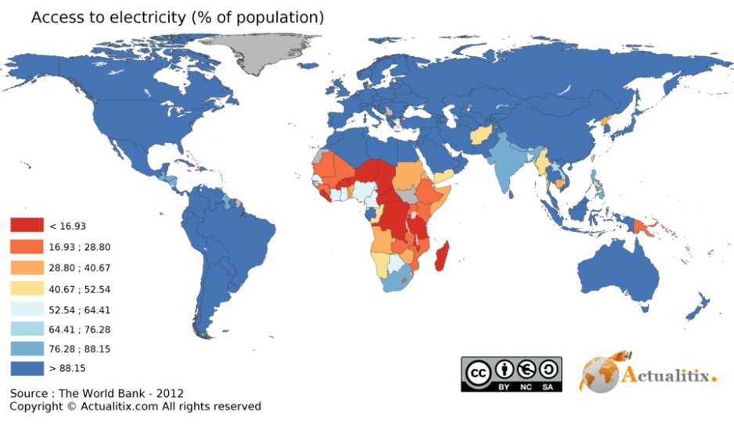
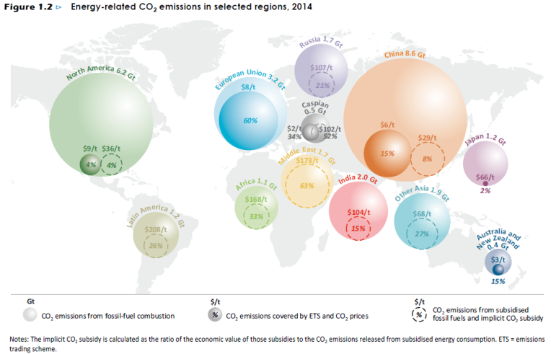
Facts & figures
Energy poverty
Energy financing
Annual requirement for the period from 2010 to 2030 to achieve the universal access to modern energy services and doubling the share of renewable energy in the global mix :
$50 billion for energy access (current spending is $9 billion)
$442-650 billion for renewable energy (current baseline of $258 billion). $560 billion for energy efficiency (current spending is $130 billion).
(SE4All Advisory Board’s Finance Committee Report on Scaling Up Finance for Sustainable Energy Investments, 2015)
1.2 billion people without access to electricity (IEA, 2016)
3 billion people cook and heat their homes using open fires and simple stoves burning biomass (wood, animal dung and crop waste) and coal.
Over 4 million people die prematurely from illness attributable to the household air pollution from cooking with solid fuels (WHO, 2016).
Climate change

Slide 3
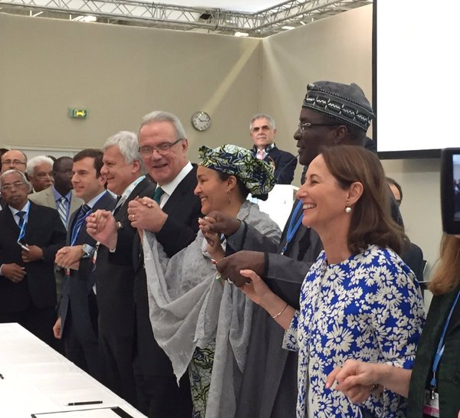
Global Vision
Africa-EU Energy Partnership (AEEP)
Sustainable Energy for All (SE4ALL) initiative - 2011
UN 2030 Agenda for Sustainable Development, SDG7 and SDG 13 - 2015
Paris Agreement – 2015
Africa Renewable Energy Initiative (AREI) - 2015

Slide 4
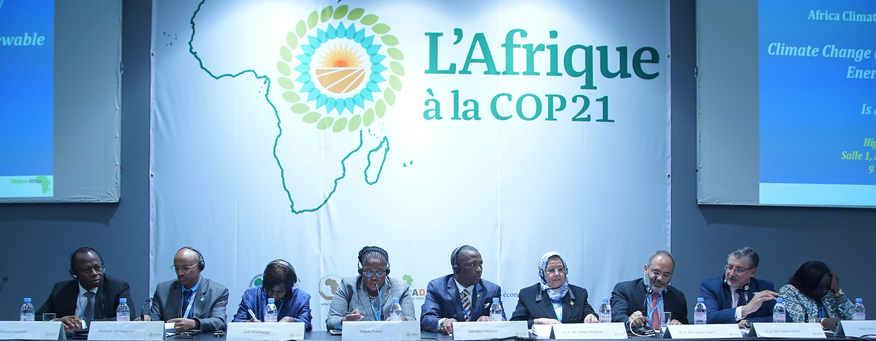
Africa Renewable Energy Initiative (AREI)
EU strongly supports AREI objectives, guiding principles and criteria
EU commitment: EUR 1.5 billion to support 5GW of new renewable energy by 2020 (half AREI objective by 2020)
Enhanced cooperation through existing instruments:
Ensuring country ownership and local socio-economic development

Slide 5
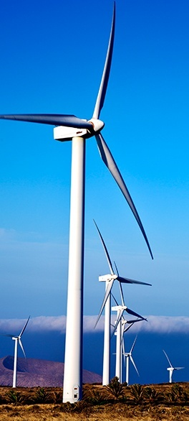
EU Vision
3 OBJECTIVES for ENERGY COOPERATION
Increase access to sustainable energy
Increase renewable energy generation capacity and energy efficiency
Contribute to the fight against climate change
Council Decision on Climate and Energy 2014 ; Council Conclusions on Energy and Development 2016 ; New European Consensus for Development; Council Conclusions on Energy and Climate Diplomacies 2017

Slide 6
Mainstreaming climate change
2030 Agenda for Sustainable Development, AAAA, Paris Agreement, Sendai Framework on DRR 2015-2020, New Urban Agenda
Linkages between SDGs and NDCs implementation
Proposal for a New European Consensus on Development
Climate change cross-cutting (People, Planet, Prosperity, Peace, Partnerships)
20% general EU 2014-2020 budget should be spent on climate action
Notes:
Climate finance will play a crucial role both for implementing the Paris Agreement and the 2030 Agenda. At least 20% of the EU budget will be spent on climate action by 2020. This means that an estimated EUR 14 billion of public grants will support climate activities in developing countries between 2014 and 2020. It is major contribution to the overall USD 100 billion goal.
Mainstreaming is considered as a key contribution towards sustainable development, poverty reduction and the implementation of the Paris Agreement
Since 2015, the EU has significantly stepped up environment and climate change mainstreaming efforts. Mainstreaming requires that non-climate policies, programmes, and/or individual actions take climate change into consideration.
In DG DEVCO we have developed tools and methods (including mainstreaming guidelines) and set up a dedicated environment and climate change mainstreaming facility. The Mainstreaming Facility has been providing advice for projects and programmes under both DCI and EDF to increase the quantity and quality of their contributions to address climate change. DG DEVCO has also intensified the training and capacity building activities, specific on environment and climate change mainstreaming (including Rio Marking) and jointly with sectorial activities (e.g. green economy or agriculture).
As a result of these efforts contributions to climate change have been increasing, from 17.7% in 2014 to 24.9% in 2016 (provisional data) under the DCI. In the case of EDF, contributions have increased from 3.3% in 2014 to 23.3% in 2016 (provisional data).
The share of climate-relevant actions in food and nutrition security and sustainable agriculture jumped from 13 % in 2007–2013 to 29 % in 2014–2015 (latest available data). In farming, adaptation and mitigation can be twin benefits, not competing needs.

Slide 7
3 pillars of cooperation
Political ownership of reform agenda
Policy dialogue, culminating in 24 Joint Declarations
Contribution to National Indicative Programmes (30 countries) and Regional Indicative Programmes: overall EUR 3.7 billion for sustainable energy (2014-2020)
Continental: AEEP, part of Joint Africa-EU Strategy
With Local Authorities: Covenant of Mayors in Sub-Saharan Africa
Technical Assistance and Capacity building
Technical Assistance Facility (TAF), EUR 40 million for Sub-Saharan Africa + EUR 10 million 'rest of the world' – to help creating an enabling environment
Investments
Regional Blending facilities
ElectriFI, Gender Window, GEEREF, ARESUF, Climate Investor One
And soon: European External Investment Plan (EIP)

Slide 8
Africa-EU Summit: Energising Africa
Joint Communication for a renewed impetus of the Africa-EU Partnership
Proposed Flagships for period 2018-2020:
Deliver the EU contribution to the AREI: 5 GW of renewable energy generation capacity by 2020, to bring access to sustainable energy to 30 million people in Africa and saving 11 million tons of CO2 per year.
High Level Platform for dialogue with private sector, to facilitate EU and Africa public-private cooperation on increased investments in the sustainable energy sector, improve the investment climate, de-risk private investments, facilitate knowledge sharing on innovative business and financing models and best practices on public finance leveraging.
Launch a new EU-Africa Research and Innovation Partnership on climate change and sustainable energy focusing on deployment as well as capacity building in energy efficiency and renewables.

Slide 9
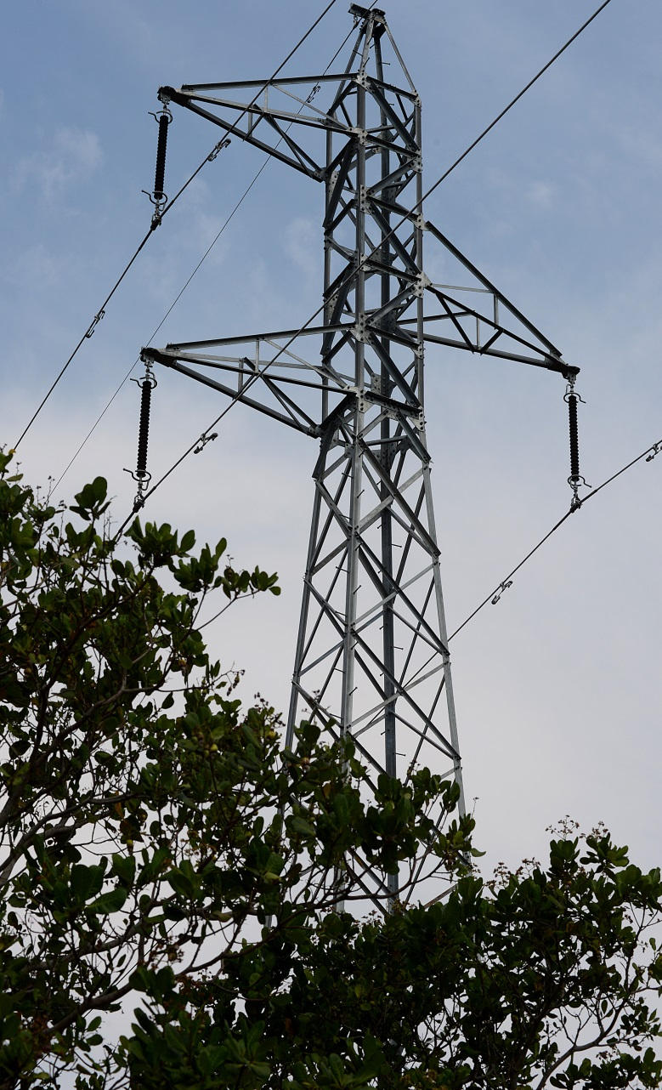
Technical Assistance Facility
Covers all partner countries, high quality expertise and support in:
policy advice
capacity building
identification of projects
mobilisation of funding
technology transfer
Supports crucial regulatory and policy reforms in partner countries' energy sectors
Assists in the fine-tuning of policies to create a conducive environment for private sector investments

Slide 10
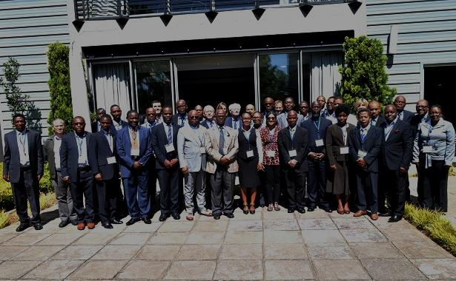
Examples of TAF assignments
Quick Wins for Energy Savings in Zambia Total potential electricity saving from 14 investigated sites may cut electricity consumption by up to 50% and significantly reduce the energy deficit in Zambia.
New Momentum for Lesotho's Rural Energy
A new, dedicated institution for "Rural Energy Action", REA, will pull together efforts focusing on Lesotho's off-grid, mountainous areas
AUC: Bringing Harmony to Electricity Markets in Africa African Energy Ministers adopt the Strategy and Action Plan for the ‘Development of a Legal Harmonized Continental Regulatory Framework for the Energy Sector in Africa’

Slide 11
EU Financial Tools
Large energy infrastructure projects (transmission, interconnectors, renewable energy generation) → blending facilities
Blending is defined as:
THE STRATEGIC USE OF A LIMITED AMOUNT OF GRANTS TO MOBILISE FINANCING FROM PARTNER FIs AND PRIVATE SECTOR TO ENHANCE THE DEVELOPMENT IMPACT OF INVESTMENT PROJECTS

Slide 12
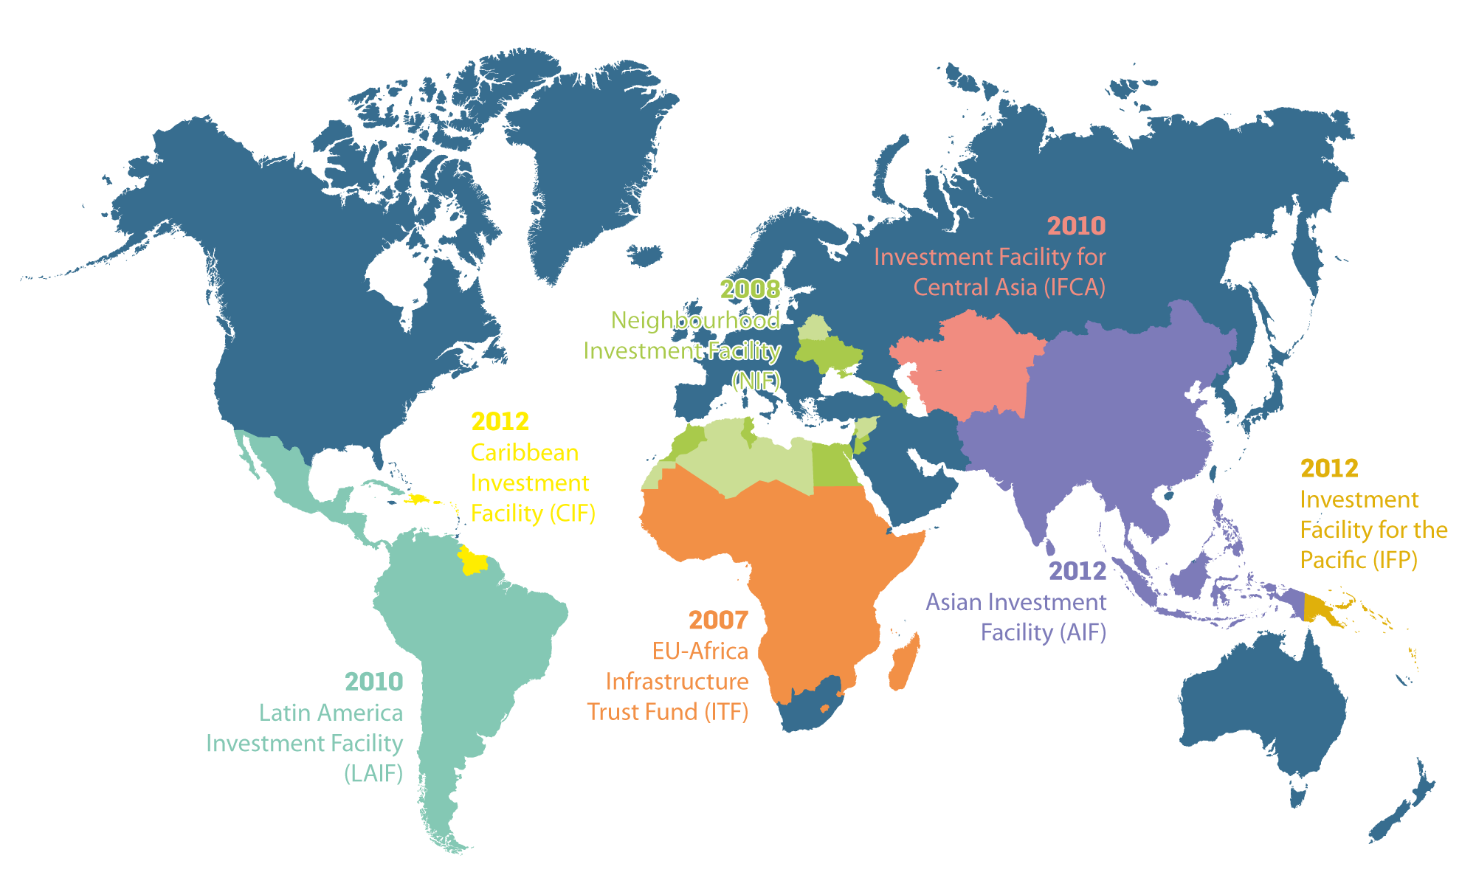
Blending facilities
7 Investment facilities set up for regions worldwide
July 2015 Africa Investment Facility (AfIF)

Slide 13
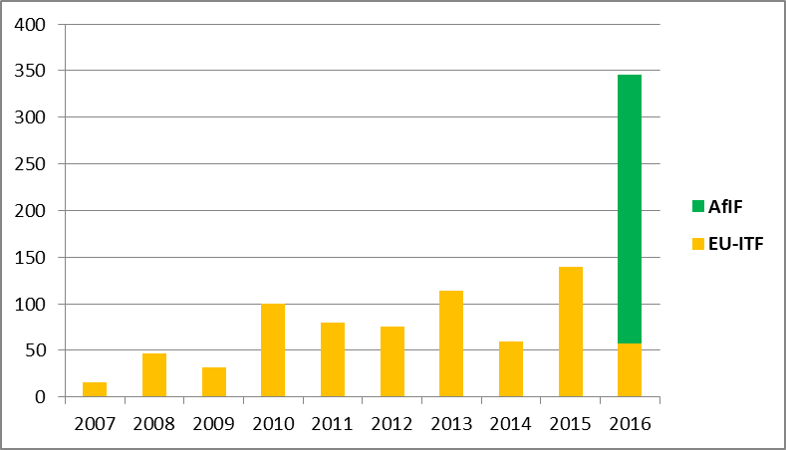
The blending facilities for Africa (ITF – AFIF)
EU Contribution
EUR 1.0BN
(EU-ITF EUR 0.7BN – AfIF EUR 0.3BN)
112 PROJECTS
(EU-ITF 96 – AfIF 16)
EFIs financing
EUR 3.8BN
(EU-ITF EUR 3.1BN – AfIF EUR 0.7BN)
Leverage: 3.8/1
Total investment
EUR 11.9BN
(EU-ITF EUR 9.6BN – AfIF EUR 3.3BN)
Leverage: 11.9/1
13

Slide 14
EU Financial Tools
Medium-sized electrification projects (typically off-grid) → new electrification financing initiative ElectriFI
EUR 132 M allocated so far (thematic funds) + USD 10 M contribution from Power Africa (more in the pipeline)
ElectriFI objectives:
boost mobilisation of private sector investments in increasing and/or improving access to sustainable electricity and energy services,
encourage actions with emphasis on decentralised sustainable energy solutions for populations living principally in rural or underserved areas

Slide 15
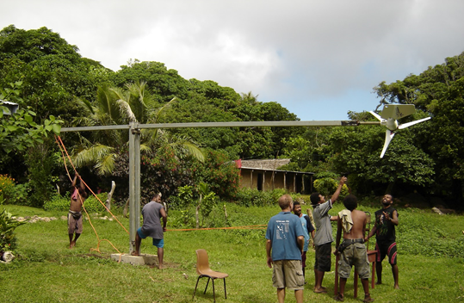
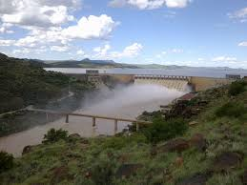
Common challenges in accessing finance for Energy Investments
Too big for some, too small for others; or too risky a combination of factors
unproven techniques
developers/companies with limited track record
collateral not available
unbalanced capital structure (not enough equity)
flexible financing required (no straight repayments) etc.
As a result, many impactful initiatives that have the potential to become financial sustainable do not come off the ground, or come too slowly, to address the need for reliable, affordable, sustainable and modern energy

Slide 16
ElectriFI-FMO www.electrifi.eu
Investment facility to increase access to renewable energy (mainly decentralised) with the private sector sharing high-risk in projects business plan with loans.
Ticket size: min. EUR 500k - max. EUR 10mln (Small- to medium-scale)
Product range: Equity, Quasi-equity, Debt and Development Finance
2016 1st Call > 290 applications received
19 applications pre-selected (4 received final approval already)
2017 2nd Call > 155 applications received
evaluation is ongoing (65 project host countries, business models - IPP (state or municipal off-taker), Utility (Mini-/Micro-/Nano-Grids), SHS, Captive Power - Private off-taker, Mobile power unit, telco tower)

Slide 17
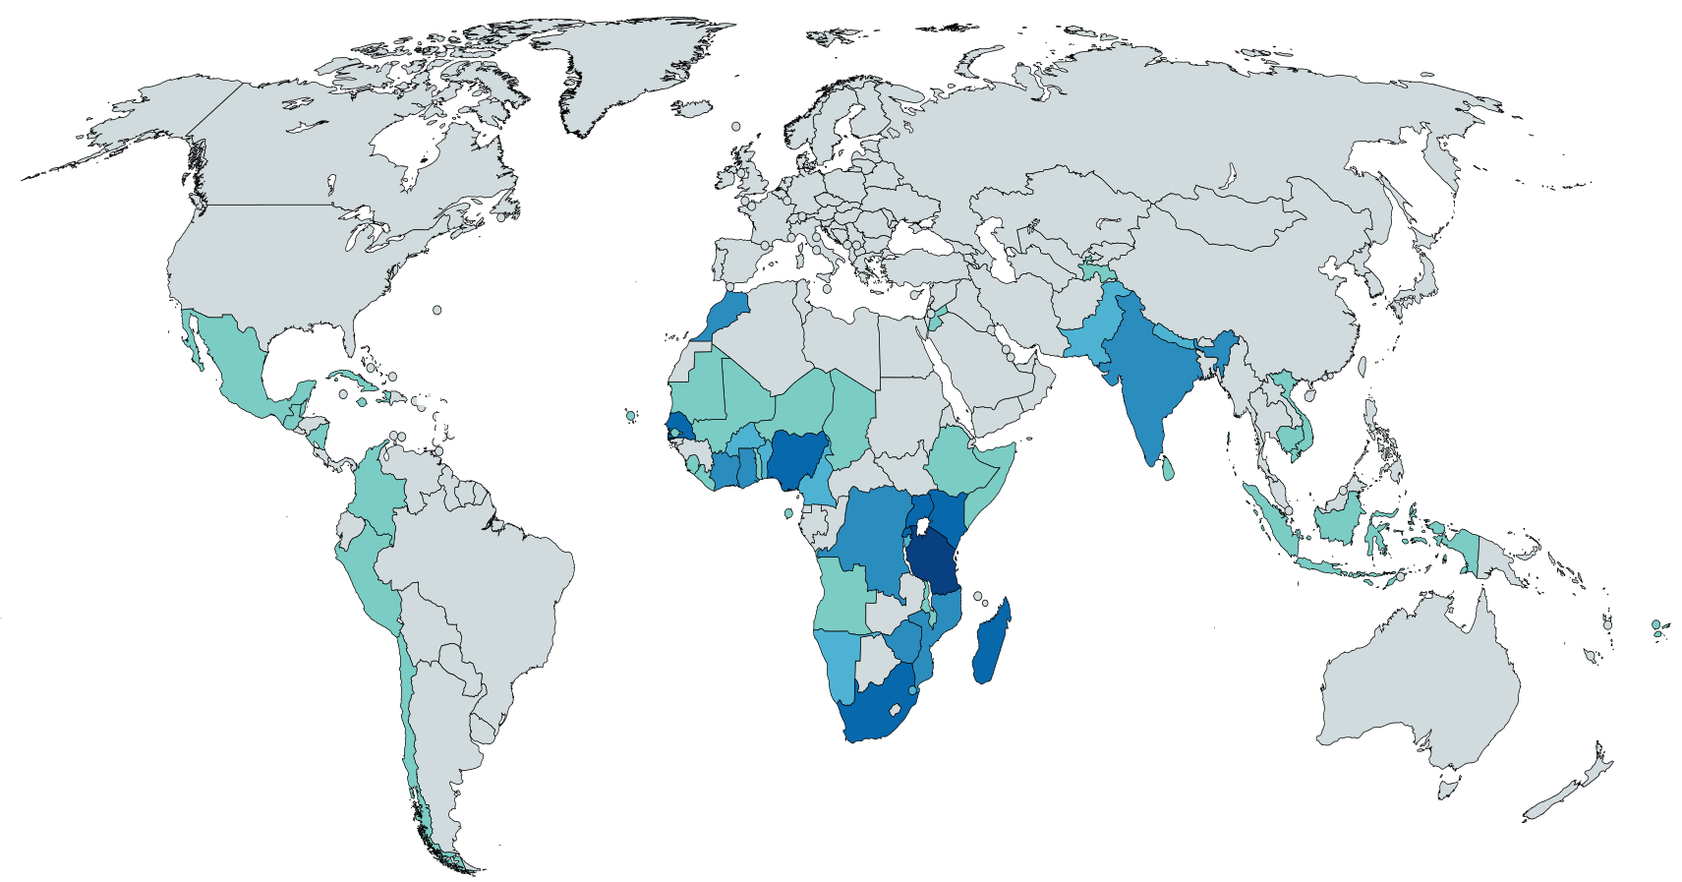
Response to ElectriFI
1st call for proposals: 290 Applications from 55 project Host Countries
Africa 85% of which:
155
25
East 34%
Southern 26%
West 26%
Other 14%
Countries >10 projects
Tanzania 34
Zambia 23
Nigeria 19
Kenya 18
Uganda 14
Rwanda 13
Senegal 13
Madagascar 12
South Africa 10
0 to 2
3 to 5
6 to 10
11 to 20
>20

Slide 18
Response to ElectriFI
155
25
Business Models
Technologies

Slide 19
Women and Sustainable Energy
Support women's economic empowerment through:
Jobs & entrepreneurship in the energy sector
Productive uses of energy
Vocational training, political advocacy and awareness campaigns
Within the larger EU Gender Action Plan
EUR 20 million allocation to Call for proposals (ongoing)

Slide 20
Covenant of Mayors for Sub-Saharan Africa
Part of the Global Covenant of Mayors for Climate and Energy, global initiative with 3 focuses: mitigation – adaptation – energy access
Increasing energy access, energy efficiency, and planning capacity for resilient urban design and mobility
Main activities up to now: Technical Assistance Platform, projects at city level (11 financed so far)
Next phase: scaling up and bridge the gap to investments

Slide 21
EU research and innovation on energy in development cooperation
Cooperation programme with RTD
In the framework of Horizon 2020
Work plan on renewable energy: a flagship for Africa?
In the framework of the Africa-EU partnership
High level policy dialogue (HLPD) on Science, Technology and Innovation
A new topic on Climate change and renewable energy might be launched during the Africa-EU Summit in November

Slide 22
Upcoming External Investment Plan
3 Pillars Structure
EIP
1
2
3
European Fund for Sustainable Development (EFSD)
Mobilising investments and improving access to finance
EFSD Guarantee Fund (especially for the private sector – Guarantee €1,5 bn)
Regional Investment Platforms (Africa and the EU Neighbourhood - € 2,6 bn)
Technical
assistance
To help developing bankable projects which could be financed under pillar 1
To support activities aimed at enhancing business climate under pillar 3
Enhanced Investment Climate
Political and policy dialogue for economic reforms
Support legal, institutional and regulatory frameworks
Engaging with the private sector
One-stop-shop / web portal

Slide 23
Proposed External Investment Plan
Key Innovations
Integrated 3-pillar-approach – Seizing Synergies
Coordinating finance, TA and multi-stakeholder political and policy dialogue for promoting sustainable investments in our partner countries
One-stop-shop and web portal – Enhancing transparency, accessibility and efficiency
Giving a single & simple entry point for partners, investors and private sector
EFSD Guarantee EUR 1,5 bn – Innovative instrument, providing more funds and more flexibility
Leveraging additional financing, particularly from private sector
Risk mitigation mechanism to stimulate investments in Africa and the Neighbourhood
Managed through Investment Windows: thematic and/or geographic
23

Slide 24
THANK YOU FOR YOUR ATTENTION

